Slide 1
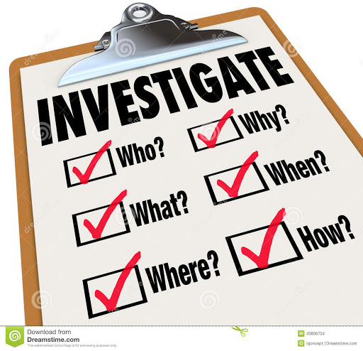
Due Process and Conducting Investigation: THE BASICS

Slide 2


During the training we will test your knowledge via quizlets

Slide 3
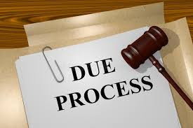
DUE PROCESS
INTRODUCTION TO TOPIC

Slide 4
The Phrase “due process” is found in the 5th and 14th Amendments to the US Constitution. Requires federal and state governments (respectively) provide substantive fairness and certain procedures before depriving life, liberty, or property interests.
Due Process means essentially a guarantee of basic fairness.
Fundamental fairness requires:
Notice
An opportunity to be heard at a specific time and in a meaningful way.
A decision supported by evidence that meets the standard of proof.
Due process is not a single event that occurs in isolation.

Slide 5

What Does the Way I Investigate Have to do With Due Process?
Whenever an employee is facing possible discipline based on an alleged violation of policy, they are entitled to due process.

Slide 6
Inquiries into disputed facts must be conducted in a predictable manner and:
require the parties involved (Complainant/ Respondent) receive proper notice (the Title IX Coordinator will send the notices)
require policies/impacted by allegations be outlined in specificity,
require the parties involved are given a meaningful opportunity to present and respond to evidence,
require that investigations are conducted by unbiased investigators.

Slide 7
Due Process Quizlet
Due process requires employees and students know the policies they must follow while on the job.
TRUE or FALSE
2. Fundamental fairness requires a decision regarding responsibility be supported by evidence that meets the standard of proof identified by the college?
TRUE OR FALSE

Slide 8

When to do an investigation
When you are assigned to investigate by the Title IX Coordinator.
Even if you are approached about a Title IX complaint or allegations of sexual harassment, you must refer the complaint to the Title IX Coordinator.

Slide 9
What does an investigation entail?
Investigations should be done both promptly and thoroughly—employing a two-investigator model.
Interviewers should plan all interviews carefully—including the order of the interviews—and should prepare a list of detailed questions designed to gain information that might prove or disprove the complaint.
NEVER rely solely on memory. Take good and detailed notes and gather supporting documents (texts, emails, pictures, etc.).
Review the Complainant’s statement or interview notes. The Complainant should be interviewed first to clarify the details of the complaint.
Don’t take allegations as fact.

Slide 10
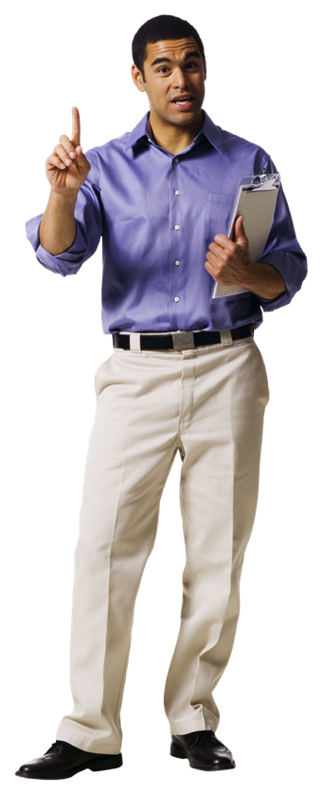
The “musts” in an investigation
Your investigation MUST be documented in writing.
2. Your investigation MUST be thorough.
3. Your investigation MUST be timely.
4. Your investigation must be impartial and must not be biased.

Slide 11
On What Should Investigations Focus?
On the effect of the behavior/conduct
On expected standards of behavior, as delineated in the policy and to gather facts related to the allegations being made
On context. When, where, and in front of whom did the alleged action take place? Were there witnesses? Did the situation occur at the work place?
On patterns of behavior. Prior complaints? Prior discipline? ← this is helpful for the sanction phase
On seeking corroboration

Slide 12
Words have special meanings
The person who brings a matter to our attention is a “Complainant” and not a victim or survivor. The reported conduct is not a case or claim.
If the report is made regarding someone, that person is a “Respondent” of the investigation, not a target or perpetrator.
Using proper terminology reinforces your role as a neutral fact finder.

Slide 13
When to Investigate Quizlet
When the Respondent admits to the conduct alleged by the Complainant there is no need to conduct an investigation or document the complaint and admission.
TRUE or FALSE
You have been selected to conduct an investigation into allegations of sexual harassment. Knowing the Respondent is about to retire, it is appropriate to:
document the complaint, but due to the circumstances, not investigate;
investigate immediately;
place the employee on paid leave until they retire.

Slide 14

Let’s review the
Investigative Checklist

Slide 15
Scope of the Investigation = Establishing parameters Identifying the scope is the most critical responsibilities facing investigators.
Too Narrow of a Scope
Too Broad of a Scope
Risk missing important pieces of evidence
Risks missing additional, but related, violations
Gives the impression that the investigation is being undertaken for the sake of appearance, and not to uncover wrongdoing
Risks investigations dragging on
Risks wasting resources and productivity
Risks causing loss of credibility in the process (creating fishing expeditions)
Risks becoming a distraction to others

Slide 16

Scoping an investigation =
Developing an investigative plan
Let’s review the 5 Reminders Handout

Slide 17


Investigation Do’s and Don’ts
DON’T
DO
Don’t ignore complaints
Don’t be an investigator who is perceived to be biased
Don’t think someone else will investigate, so you don’t have to.
Don’t delay in starting the investigation.
Don’t ignore “off the record” complaints—there is no such thing.
Do follow up on each and every complaint, regardless of what you believe the merit of the complaint may be.
Do be an investigator who is knowledgeable, fair, and unbiased.
Do investigate all allegations.
Do allow for flexibility with your investigative plan.
Do provide all parties with the prohibition against retaliation and the knowledge that you are a neutral fact-finder.

Slide 18
Investigation Quizlet
The scope of the investigation is the most important aspect of the investigation and should not change at all during the investigation.
TRUE or FALSE
In order to ensure fairness, you should interview the same number of witnesses on each side (the reporter and the subject)
TRUE or FALSE
Investigators must make credibility determinations after all of the interviews have been completed.
TRUE or FALSE

Slide 19
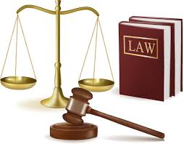
Documentation

Slide 20
Types of Documentation
Primary Documentation: Intake sheets/reporting forms can outline the allegations being made. The intake/report sheets are a good first step in the reporting and documenting process. Written statements are also primary documentation.
Secondary Documentation: The impressions and conclusions from the investigator’s interviews and conversations with interviewees.
Tertiary documentation: Information from external or third parties may include text messages, emails, reports, created by or sent by others. External documentation will vary in its relevance and value.

Slide 21
Why is documentation necessary?
All documentation should be numbered and include the name of the investigators, the interviewee.
Any collected documentation (texts, emails, reports, etc.) must be labeled and listed on the evidence log.
Let’s look at the Evidence Log and the Privilege Log

Slide 22

Standard of Proof (Evidentiary Standard)
Preponderance of the Evidence: Judgment in favor of the complaining party if he/she is able to show that a particular fact or event was more likely than not to have occurred.
Notes:
The NPRM states that these First Amendment/free speech conditions are a way to promulgate Executive Order 13864, “Improving Free Inquiry, Transparency, and Accountability at Colleges and Universities,” signed by President Trump on March 21, 2019, which directed federal agencies, such as the Department, to “take appropriate steps, in a manner consistent with applicable law, including the First Amendment, to ensure institutions that receive Federal research or education grants promote free inquiry, including through compliance with all applicable Federal laws, regulations, and policies.”

Slide 23
5 Principles of Preponderance Standard
Levels the playing field. It is meant to ensure no advantage to one party over another.
2. Easily met. Preponderance is a minimal and easily met standard. You should not be looking for compelling proof.
3. Who do you believe. If you simply believe one party and not another, a preponderance can be met by that alone.

Slide 24
4. Definition
Black’s law dictionary calls preponderance 50% plus a feather; so any slight evidence leaning towards one side is enough.
5. Benchmark
If you believe you need more than the weight of a feather, you are not following the preponderance of evidence standard.

Slide 25
Documentation and Standard of Proof Quizlet
Select the option that best defines undisputed facts. a) one party was more credible, so the fact is undisputed.
b) the fact can be verified through documentation,
c) more witnesses confirmed that fact than did not.
It is acceptable to outline in the investigative report that a determination could not be made because there were no witnesses to the conduct/event.
TRUE or FALSE

Slide 26
Inculpatory/Exculpatory Evidence
Inculpatory
Exculpatory
Inculpatory evidence is evidence that establish the “guilt” of the subject.
Inculpatory evidence shows, or tends to show, the subject’s involvement the alleged act.
For example, inappropriate text messages sent by the subject to the reporter are inculpatory evidence of inappropriate behavior.
Exculpatory evidence is evidence that tends to show that the subject has not engaged in the alleged behavior.
For Example, in the investigation, 5 of 5 witnesses confirm that the subject was not in the meeting where the alleged behavior took place, even if there is no written documentation of who was at the meeting.

Slide 27
What are Title IX investigations to determine?
Your job is to determine whether evidence is out there. You are not making determinations as to whether a policy was violated.
Your documentation should not address legal standards or try to fit the facts to legal standards.
In Title IX investigations, your job is to complete an investigation ONLY. You ask the right questions, talk to the right people, and set up the evidence so the determination of responsibility can be made at the hearing.

Slide 28

Training created by Melissa Flores, Associate General Counsel, Sr. at Maricopa County Community College District, 2020.
Used with permission.

Slide 29


