Slide 1
Pre-Training Question
What word best describes your feelings about serving as a Title IX Coordinator under these new regulations?

Slide 2

WHAT ARE ALL THESE TEMPLATES FOR AND HOW DO I USE THEM?
Title IX
Coordinator
Training

Slide 3
2020 Training Dates
Monday, August 3, 2020 @ 1:00-5:00PM
Tuesday, August 11, 2020 @ 8:00 AM-12:00 PM
Monday, August 17, 2020 @ 1:00-5:00 PM
Wednesday, August 19, 2020 @ 8:00-12:00 PM
All training will be conducted virtually.
Roll-call at the top of the hour will mark attendance.
Attendance logs will be sent to Title IX Coordinators.
Training will be posted on the Title IX website following the August 3rd training.

Slide 4

agenda
An introduction to the new role of a Title IX Coordinator
A look at the new templates
A timeline for sending the templates
Keeping up with the simultaneous messaging
Specifics: Introduction to the new 2020 Regulations, Inspection of Records, Emergency Removals, Recordkeeping requirements

Slide 5

The New Role of the Title IX Coordinator:
THE CONDUCTOR
Under these new regulations, the Title IX Coordinator is the conductor of the symphony that is the Title IX Grievance Process.
You direct EVERYTHING and you keep things moving!
Investigators
Advisors
Hearing Facilitators
Decision-makers
Witnesses
Appeal
officer
Respondents
Complainants
BIT teams

Slide 6
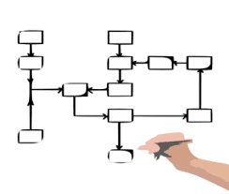
In order to assist you in your new role, we have created letter and report templates, flowcharts, and related information that will direct your communication with the Parties.

Slide 7

LETS JUMP ON IN!
What are the
new
templates
and when do
I send them?

Slide 8

Title IX Coordinator receives actual knowledge of allegations of sexual harassment or information about possible sexual harassment
Preliminary review of the allegations
Do the allegations meet the definition of sexual harassment under the regulations?
Does the complainant want to seek informal resolution or file a formal complaint?
Does the Title IX Coordinator need to sign a complaint based on threat to safety of community?

Slide 9
Topic: Dismissal Notification and Appeal Letters
Mandatory Dismissal of Title IX Case Template (to be sent to both parties)
Discretionary Dismissal of Title IX Case Template (to be sent to both parties)
Appeal of Mandatory/Discretionary Dismissal Approved Template (to be sent to both parties)
Appeal of Mandatory/Discretionary Dismissal Denied Template (to be sent to both parties)

Slide 10

Ok, you have a formal complaint
Both parties must be informed of the option to secure an Advisor of their choosing.
Does the Complainant want an informal resolution?
Does the Respondent agree to participate in the informal process?
If not, investigators need to be assigned. Make sure they get a copy of the Evidence and Privilege logs and that they USE THEM!
Notifications need to go out to both parties.
Anytime there is a change in the allegations being made, an amendment NOA needs to be sent out.

Slide 11
Topic: Notice of Allegations Letters
Faculty Respondent Notification of Allegations template
Respondent (non faculty) Notification of Allegations template
Complainant Copy of Notification of Allegations template
Respondent (non faculty) Amendment to Notification of Allegations template
Faculty Respondent Amendment to Notification of Allegations template
Complainant Amendment to Notification of Allegations template

Slide 12

Is there a need for an Emergency Removal?
Pull out the protocols for an emergency removal and the 5 Step Process—this is the documentation template you will place in the file.
You will have to get your college BIT, TAT (or whatever you call it) team together to do a threat assessment.
If the emergency removal is elected, you must send the notification to the Respondent—and follow through with their supervisor (if employee) to get them off campus. You must send the notification to the Complainant that the Respondent has been removed)
If the show cause meeting is requested, you must notify the Complainant and invite them to the meeting.
After the show cause meeting, you must decide on modifying, staying, or enforcing the removal.
Notify both parties of the decision
If no show cause meeting requested, notify both parties that the emergency removal decision is closed.

Slide 13
Topic: Emergency Removal Templates
Protocol for Emergency Removals
Five Step Process for Emergency Removals: Documentation
Faculty/Staff Respondent Notice of Removal Template
Student Respondent Notice of Removal Template
Complainant’s Notice of Respondent’s Notice of Removal Template
No Show Cause Meeting Requested Template
Complainant’s Copy of No Show Cause Meeting Requested Template
Complainant’s Notice that a Show Cause Meeting was Requested By Respondent Template
Show Cause Determination Template
Complainant’s Show Cause Determination Letter Template

Slide 14

The investigation is complete
Once the investigation is complete, it is time for the first inspection period. Pull out the inspection period protocols.
You must prepare the information collected during the investigation (see next slide).
You will notify the parties of the inspection period.
You will either mail (during COVID) or hold the information for pick up.
You will have the parties sign the non-disclosure agreement before giving them the information.
You will retrieve the information and collect the responses to the evidence/records from the parties and send them to the investigators for review.

Slide 15
MORE
1. The second inspection period comes after the investigators have reviewed the parties’ responses to the investigation documents.
2. You will, again, notify the parties of the second inspection review.
3. You will prepare the investigation report for inspection
4. You will either mail (during COVID) or hold the information for pick up.
5. You will have the parties sign the non-disclosure agreement before giving them the information.
6. You will retrieve the information and collect the responses to the evidence/records from the parties and send them to the investigators for review.

Slide 16

Preparing the Material for Inspection
You will upload the investigation information on a NexCopy flash drive and notify the parties to pick up the drive. You will need to download the Nexcopy software in order to upload and copy protect the information.
NexCopy flash drive features:
The content can be viewed, but cannot be:
Copied
Deleted or otherwise altered (documents must be put in PDF or JPEG)
Printed
Copy and Pasted
Screen grabbed
You can put a time expiration for the viewing of material
The flash drive is Mac and PC compatible

Slide 17
Topic: Inspection of Evidence and Records Documents
Inspection of Evidence Procedures
Inspection of Records Flowchart
First Inspection Period Notification Letter (for both parties)
Second Inspection Period Notification Letter (for both parties)
Non-Disclosure Agreement
Title IX Evidence Log
Title IX Privilege Log

Slide 18
Topic: Report Documents
Final Title IX Investigation Template
(This document is used for the second inspection of records) ← the investigators prepare this document.
Final Written Determination of Responsibility Template ← you prepare this one with the help from the Decision-maker’s determination letter.
(This document is used after the hearing)

Slide 19


It’s Hearing Time!
You will send out the referral to a hearing letter to both parties.
You will assign a Hearing Facilitator to help the proceeding run smoothly.
You will get the technology ready for the hearing.
You will attend the hearing, answer questions, or provide information regarding the procedural nature of the case.
You will send out the Notice of Outcome letters with the Final Determination of Responsibility.

Slide 20
Topic: Referral to a Hearing Documents
Notice of Hearing (for both parties)
Topic: Notice of Hearing Decision Documents
Notice of Outcome. Respondent Not Responsible Template
Notice of Outcome. Respondent Responsible Template
Notice of Outcome Letter for Complainant. Respondent Not Responsible Template
Notice of Outcome Letter for Complainant. Respondent Responsible Template

Slide 21


I’ll see your hearing… and raise you an appeal!
You will inform the parties that an appeal has been or has not been filed and offer the chance for the parties to write a response to the appeal request.
You will send out letters letting the parties know the appeal is dismissed for lack of grounds or that it has been accepted for appeal.
You will send a copy of the appeal letter to both parties and to the investigators or decision-maker for comment.
You will collect the statements and present the appeal to the Appeal Officer for review.

Slide 22
Topic: Appeal Notification Documents
Complainant’s Copy that Hearing Appeal has been filed by Respondent template
Complainant’s Copy that No Hearing Appeal Requested Template
Respondent’s Copy that Hearing Appeal has been filed by Complainant Template
Respondent’s Notice that No Hearing Appeal Requested Template
Notice that No Hearing Appeal Requested Template (this goes to both parties when no appeal filed)

Slide 23


The Appeal is in Process….and Done!
1. If an appeal is requested, you will route the appeal request to the Appeal Officer (for MCCCD, this is the Provost) and you will notify both parties that an appeal (including who filed it) has been requested.
2. If an appeal is not requested, you will notify the parties of this fact and indicate that the case is closed and the hearing decision stands.
3. The Appeal Officer may dismiss the appeal for lack of grounds or accept the appeal. Either way, there will be a letter sent out by the Appeal Officer (you will assist, as needed.
4. The Appeal Officer may send letters to the parties as well as the investigators and/or decision-maker for information that will aid in the appeal determination.
5. Once the appeal decision is made, you will assist the Appeal Officer in sending out the decision letters.
6. You will ensure the appeal decision is implemented.

Slide 24
Topic: Appeal Officer Letters
Appeal Officer Letter RE: Appeal Accepted and Procedure for Appeal Template (Both Parties)
Appeal Officer Letter RE: Dismissal Lack of Grounds Template (Both Parties)
Appeal Officer Letter RE: Information from Investigators or Decision-maker Template (Both Parties)
Appeal Officer Letter RE: Appeal Denied (Both Parties)
Appeal Officer Letter RE: Appeal Granted and Next Steps (Both Parties)

Slide 25
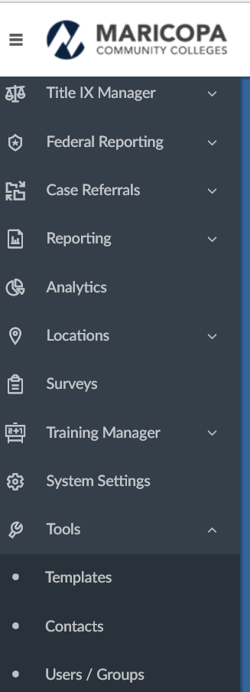
Where can the templates be found?
All templates can be found in the Symplicity System.
Log in and get to the home page.
Scroll down on the left hand side of the home page until you see the word TEMPLATES
Click on TEMPLATES. Then scroll over to CATEGORY. Click on Category and scroll down to Title IX.

Slide 26
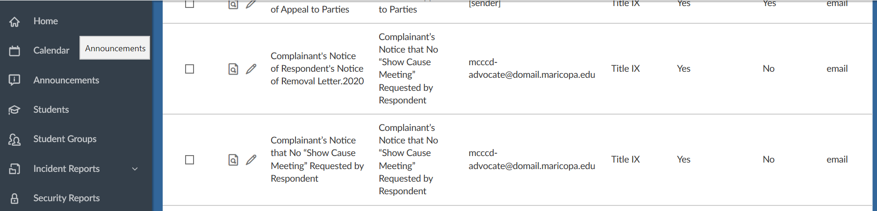
The names of the templates and reports will be listed in this template repository.
Once Symplicty releases the 2020 update, we will upload the templates into the workflow for ease in sending the letters.

Slide 27

Keeping up with the simultaneous messaging
Tips for keeping track of the messages you must send:
Map out each complaint that comes your way. Identify whether the case is going to follow the Title IX grievance process or another investigative process. NOT EVERY SEXUAL HARASSMENT/DISCRIMINATION CASE WILL GO THROUGH THIS PROCESS.
              2. Remember that everything you send to one party must be sent to the other. In some cases you will send a copy of the same letter (you will see the CC on the template) or you will send a separate letter. You will never write a substantive letter to a party without sending something to the other.
              3. Take your time. The regulations do not require an investigation be completed within a certain time period. The time period must be reasonable (no reasonable delays).

Slide 28


Templates Quizlet

Slide 29
1. You must send a decision letter to both the Complainant and the Respondent when you complete the preliminary review of the complaint.
TRUE or FALSE
2. As the Title IX Coordinator, you will complete the Final Investigation Report before the second inspection of evidence/record period.
TRUE or FALSE
3. Advisors are required to receive a copy of every letter you send to their advisees. TRUE or FALSE

Slide 30

Introduction to the 2020 Title IX Regulations

Slide 31
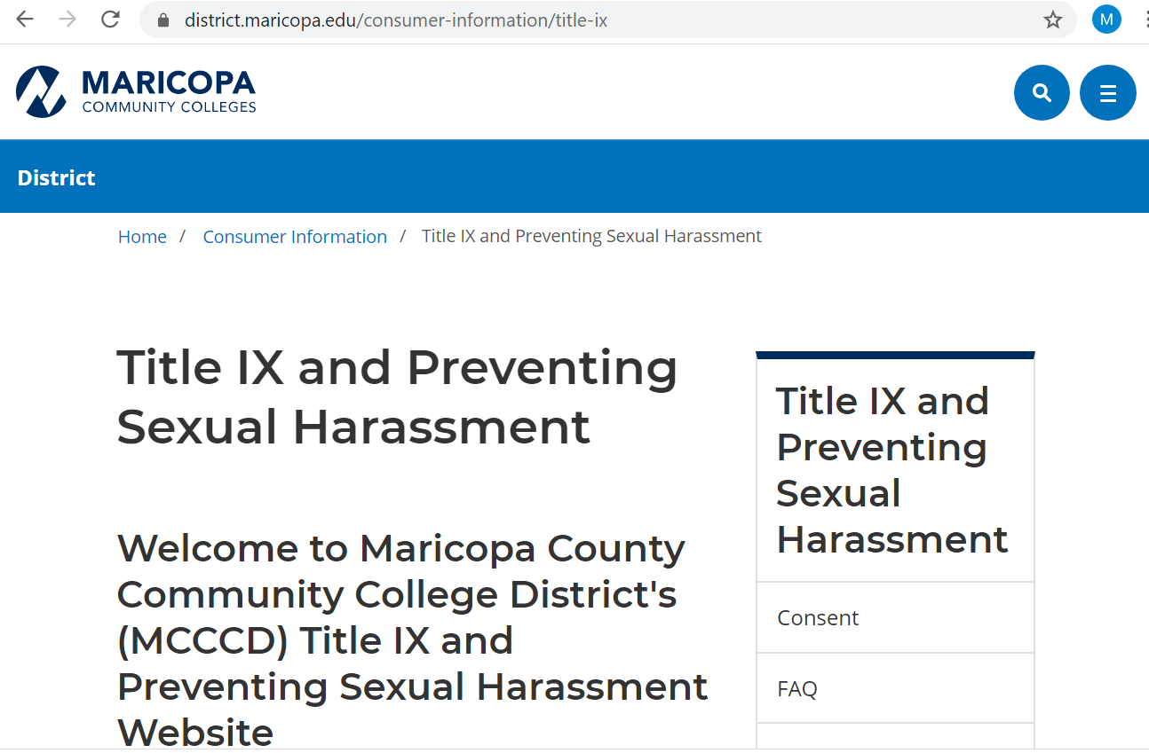

Slide 32

Substantial
Policy Changes:
This policy applies to employees and students equally
When and how an institution receives “actual knowledge” of sexual harassment or allegations of sexual harassment.
The definition of sexual harassment.
The definition of a school’s “education program or activities” and “in the United States.”
Expanded obligation to ensure is educational community knows how to report to the Title IX Coordinator.
The institution’s obligation to respond (in a manner not deliberately indifferent)
Definition of formal complaint (incl. mandatory and discretionary dismissals)
The requirement for live hearings.
Standards of Evidence
Appeals required

Slide 33
Actual Knowledge, Definition of Sexual Harassment, and Definition of Program of Activity, in the U.S.
Actual knowledge: Notice of sexual harassment or allegations of sexual harassment to the Title IX Coordinator or any Official with Authority (authority to institute corrective measures on behalf of the institution). Mandatory reporters ≠ convey actual knowledge.
Definition of Sexual Harassment: Sexual harassment means conduct on the basis of sex that satisfies one or more of the following: (i) A school employee conditioning education benefits on participation in unwelcome sexual conduct (i.e., quid pro quo); or (ii) Unwelcome conduct that a reasonable person would determine is so severe, pe1vasive, and objectively
offensive that it effectively denies a person equal access to the school's education program or activity; or (iii) Sexual assault (as defined in the Cle1y Act), dating violence, domestic violence, or stalking as defined in the Violence Against Women Act (VAWA).

Slide 34
Education program or activity includes locations, events, or circumstances over which the school exercised substantial control over both the respondent and the context in which the sexual harassment occurs, and also includes any building owned or controlled by a student organization that is officially recognized by a postsecondary institution
Against persons in the United States.
Conduct that does not meet this definition can be addressed through the code of conduct or employee conduct policies

Slide 35
Expanded obligation to ensure knowledge of how to report
Each school must notify applicants for admission and employment, students, parents or legal guardians of elementary and secondary school students, employees, and all unions, of the name or title, office address, electronic mail address, and telephone number of the employee or employees designated as the Title IX Coordinator.
Mandatory Response Obligation
A school must respond promptly to Title IX sexual harassment in a manner that is not deliberately indifferent, which means in a way that is not clearly unreasonable in light of the known circumstances.
Offering supportive measures, Title IX Coordinator promptly contacting Complainant to discuss their wishes to file a formal complaint, contacting law enforcement, and following a grievance process.

Slide 36
Policy Changes Quizlet #1
Two students in a Math class have been talking about the amount of homework in their class. One student turns to the other and says, “if you sleep with me, I will do your homework.” This situation is covered under the new Title IX Regulations.
TRUE or FALSE
Kevin, a current student, has been receiving threatening and violent emails and text messages from a male student who was part of the Ireland study abroad trip from which Kevin recently returned. The male student who is sending the emails to Kevin is still in Ireland. This situation is not covered under the new Title IX Regulations.
TRUE or FALSE

Slide 37
Formal Complaint
A document filed by a Complainant or signed by the Title IX Coordinator alleging sexual harassment against a Respondent and requesting that the school investigate the allegation of sexual harassment (Complainant must be participating in or attempting to participate in the education program or activity).
A formal complaint may be filed in person, by mail, or by electronic mail, by using the contact information required to be listed for the Title IX Coordinator, and by any additional method the school designates.
Where the Title IX Coordinator signs a formal complaint, the Title IX Coordinator is not a complainant. The Title IX Coordinator must comply with requirements for all Title IX personnel to be free from conflicts and bias.

Slide 38
The grievance process must provide for a live hearing.
At the live hearing, cross-examination is permitted.
Cross-examination must be conducted directly, orally, and in real time by the party’s Advisor of choice. If party has no Advisor, institution must assign one for cross-examination.
The live hearing will occur with the parties located in separate rooms with technology enabling the decisionmaker and parties to simultaneously see and hear the party answering questions
Before a Complainant, Respondent, or witness answers a cross examination or other question, the Decision-maker must first determine whether the question is relevant and explain any decision to exclude a question as not relevant.

Slide 39
More on Live hearings
If a party or witness does not submit to cross examination at the live hearing, the decision-maker must not rely on any statement of that party or witness in reaching a determination regarding responsibility and cannot draw an inference regarding responsibility based solely on a party’s or witness’s absence from the live hearing or refusal to answer cross-examination or other questions.
Advisors ask questions. The parties cannot.
Schools must create an audiovisual recording, and make it available to the parties for inspection and review.

Slide 40
Standard of Evidence
An institution can choose to use either the preponderance of the evidence or clear and convincing evidence.
The evidence standard used in Title IX cases must be the same used for formal complaints against students as for formal complaints against employees, including faculty.

Slide 41
Appeal right for both parties
Institutions must offer both parties an appeal from a determination regarding responsibility, and from a school’s dismissal of a formal complaint or any allegations
Grounds for appeal:
procedural irregularity that affected the outcome of the matter;
new evidence that was not reasonably available at the time the determination regarding responsibility or dismissal was made, that could affect the outcome of the matter; and/or
the Title IX Coordinator, investigator, or decision-maker had a conflict of interest or bias that affected the outcome of the matter.

Slide 42

Policy Changes Quizlet #2
1. A formal complaint may be filed in person, by mail, or by electronic mail.
TRUE or FALSE
2. It is permissible to prepare your cross-examination questions and submit them to the Decision-maker before the hearing for a relevance determination.
TRUE or FALSE

Slide 43
Other policies that may be at issue
Always look for other policies that may be affected by the allegations. For example: Acceptable Use (Internet), Student Code of Conduct, Professional Behavior, discrimination (protected categories).
These additional policies can be charged in the investigation and the decision-maker can make determinations on these policy violations.

Slide 44
Inspection and Review of Evidence/Records
Title IX regulations require both parties have:
An equal opportunity to inspect and review
any evidence obtained as part of the investigation
that is directly related to the allegations raised in a formal complaint
including the evidence upon which the MCCCD does not intend to rely in reaching a determination regarding responsibility
and inculpatory or exculpatory evidence whether obtained from a party or other source,
The opportunity to meaningfully respond to the evidence prior to conclusion of the investigation.
All evidence the parties want the investigators to consider in the case MUST be provided to the investigators before the first inspection period begins. Any additional evidence offered by either party WILL NOT BE ADMISSIBLE.
Inspection and Review of Evidence--Two inspection periods.
First and Second Inspection Period:
All evidence will be available at the hearing to each party.

Slide 45
Emergency Removal Process
An immediate threat to the physical health or safety of any individual.
Cannot be tantamount to a determination of responsibility or a sanction.
The College (or District) will implement the least restrictive emergency actions possible in light of the circumstances and individual safety concerns.
Examples of supportive measures include, but are not limited to:
temporarily re-assigning an employee,
restricting a student’s or employee’s access to or use of facilities or equipment,
allowing a student to withdraw or take grades of incomplete, without financial or grade penalty,
authorizing an administrative leave,
suspending a student’s participation in extracurricular activities,
suspending a student’s employment,
suspending a student’s participation in student organizational leadership, or
suspending a student’s participation in intercollegiate/intramural athletics.
A Risk Analysis must be performed—and you can’t do it alone!

Slide 46
Live Hearings: How to conduct one
Pre-Live Hearing Conference: Either part may request a live-hearing conference where you will go over the role each party, expectations, and technology.
The complainant and respondent can’t ask questions of each other or witnesses in the hearing.
The Facilitator (logistics person) will travel between rooms to ensure technology is working and make sure things are good.

Slide 47
Quizlet on specific processes
1. The parties may mutually agree to not have a hearing at the end of the investigation.
TRUE or FALSE
2. At the end of the first inspection period the respondent provides in the written response the names of three new witnesses that should be interviewed. The Title IX Coordinator is obligated to instruct the investigators to reopen the investigation. TRUE or FALSE

Slide 48

Training created by Melissa Flores, Associate General Counsel, Sr. at Maricopa County Community College District, 2020.
Used with permission.

