Slide 1
Scan Team Report
Growth and Development in Yuma and La Paz Counties

Slide 2
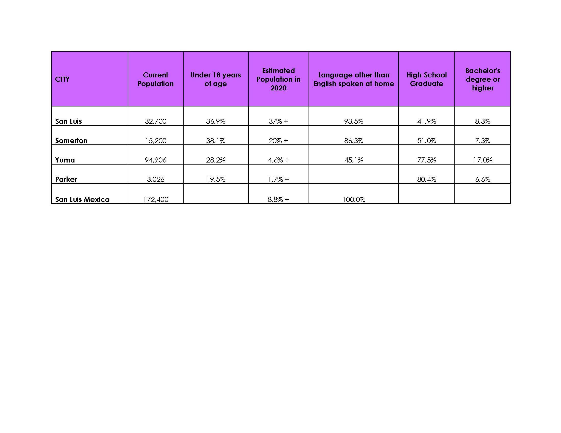
Demographics

Slide 3
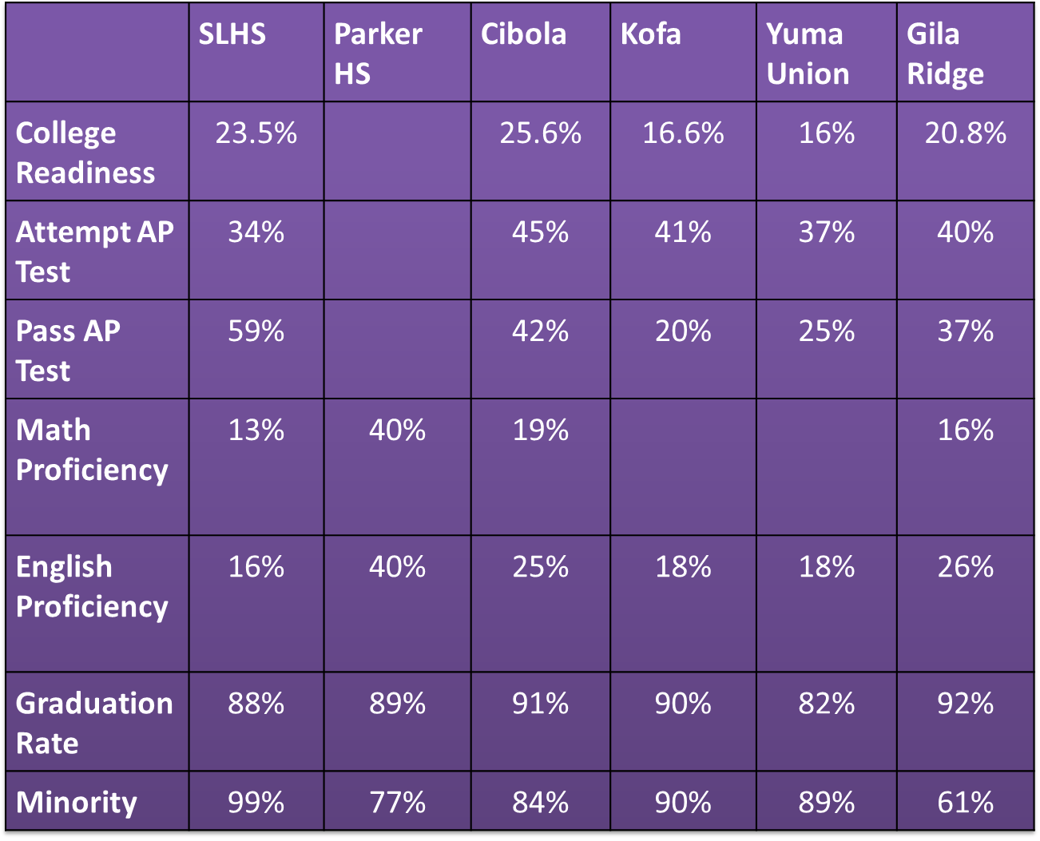
Preparedness

Slide 4
Preparedness
For many of our students, home does not function as an education resource
“Many kids come to school not speaking academically related English and a home Spanish language that is not bolstered with academic vocabularies and discourse…”
“... so many kids are living with parents born outside the U.S. who have no experience or knowledge of the U.S. school system and limited schooling in their own country”
The parents of our students have a lack of “educational capital”, or “education level and ability to promote values and behaviors that translate into academic success.”
“The poverty rate among Arizona Hispanics has been more than twice that of non-Hispanics over the past two decades”
(Hart and Hager)

Slide 5
Economic Growth
“Below-average educational attainment within a rapidly growing population [such as Latinos] can lead to:
fewer qualified workers to fill increasingly complex positions
Lower average incomes
Reduced consumer purchasing-power
More families living in poverty
Fewer residents with health insurance coverage
Greater demands on public services and benefits
Lower per-capita tax revenue
A reduced ability to attract quality businesses to the state”
(Hart and Hager)

Slide 6
Economic Growth
Increased attainment of higher education by Latinos will:
“translate to a social value gain of $660.00 per college graduate in Arizona” in the areas of reduced costs due to: health care, criminal activity, welfare reliance, college costs, and tax distortions (College Success Arizona)

Slide 7
Economic Growth
“If Arizona equalized college-going races by race - which will require substantially increasing Latino college enrollment and completion- we would produce gains of $2.3 billion” (College Success Arizona)

Slide 8
Economic Growth
“If Arizona increases postsecondary attainment to meet future workforce needs, or to equal the national average, then we will gain up to $7.4 billion” (College Success Arizona)

Slide 9
Resources Used
“3 Graphs That Explain How Higher Ed Needs to Design for the Future of Work.” Education Design Lab. 22 Dec. 2016, http://eddesignlab.org/2016/12/3-graphs-that-explain-how-higher-ed-needs-to-design-for-the-future-of-work/?gclid=CjwKCAjw0qLOBRBUEiwAMG5xMHMtpK9bmKdI4iPGWa7FtLYzAdaaMn8i5QoJQP2p8uAR-CHjjL1o-hoCQ7gQAvD_BwE
“A Coming Crisis in Teaching? Teacher Supply, Demand, and Shortages, in the U.S.” Learning Policy Institute. 15 Sept. 2016. https://learningpolicyinstitute.org/product/coming-crisis-teaching
A Matter of Degrees High-Impact Practices for Community College Student Engagement. Center for Community College Student Engagement, 2013.

Slide 10
Resources
Arizona Education Progress Meter. Expect More Arizona. 2017. https://www.expectmorearizona.org/progress/?region=Arizona
Bouillon, Rick. "STACKABLE CREDENTIALS: Pathways to Prosperity." Techniques: Connecting Education & Careers, vol. 90, no. 6, Sept. 2015, pp. 38-41. EBSCOhost, libproxy.azwestern.edu:8080/login?url=http://search.ebscohost.com/login.aspx?direct=true&db=tfh&AN=109329121&site=eds-live.
Brown, Kevin. Personal Interview. 14 September 2017.

Slide 11
Resources Used
Burton, Raquel. “Re: Teacher Shortage Numbers.” Received by Kathy Ocampo, 7 June 2017.
City of San Luis: Gateway to the Sea of Cortez. “Demographics” Retrieved 20 September 2017. http://cityofsanluis.org/340/Data-Demographics
City Population. “Mexicali”. Retrieved 3 October 2017, http://www.citypopulation.de/php/mexico-bajacalifornia.php?cityid=02002
College Success Arizona. Doubling Arizona's Economic Growth. 2016, Doubling Arizona's Economic Growth.
Elliott-Nelson, Linda. Personal Interview. 19 September 2017.
Engel, J. (2017, September 21). Email correspondence.

Slide 12
Resources Used
Ganzglass, Evelyn. “Scaling “Stackable Credentials” Implications for Implementation and Policy.” Center for Postsecondary and Economic Success at CLASP, March 2014, http://www.clasp.org/resources-and-publications/files/2014-03-21-Stackable-Credentials-Paper-FINAL.pdf.
Greater Yuma Economic Development Corp. “Sonora, Mexico.” Web. Retrieved 22 September 2017. www.greateryuma.org/our-region/sonora-mexico/
Hart, Bill, and C.J. Eisenbarth Hager. Dropped? Latino Education and Arizona's Economic Future. Arizona State University, 2012, Dropped? Latino Education and Arizona's Economic Future.
Expectations Meet Reality The Underprepared Student and Community Colleges. Center for Community College Student Engagement, 2016.

Slide 13
Resources Used
Hunting, Dan, et al. “Finding & Keeping Educators for Arizona’s Classrooms. ASU Morrison Institute for Public Policy. May 2017, https://morrisoninstitute.asu.edu/products/finding-keeping-educators-arizonas-classrooms.
Interview #2 (Dinsmore Farms):Dinsmore, J. (2017. September 28). Phone interview.
Interview #1 (Empire Caterpillar):Mann, J. (2017, September 14). Phone interview.
Institutional Effectiveness, Research, and Grants. Arizona Western College Fact Book 2015 - 2016. 2016, Arizona Western College Fact Book 2015 - 2016.
“Long Term Occupation Projections Report.” Office of Economic Opportunity, Arizona Labor Statistics. 25 October 2016, https://laborstats.az.gov/employment-forecasts

Slide 14
Resources Used
Lotts, Jim. “Re: Teacher Shortage Numbers.” Received by Kathy Ocampo, 1 May 2017.
Mangan, Katherine. “Building Remdial Ed's Support Structure.” The Chronicle of Higher Education, 5 Mar. 2017, www.chronicle.com.
Maynes, Byron. “Re: Teacher Shortage Numbers.” Received by Kathy Ocampo, 2 May 2017.
Murillo, Maria. Personal Interview. 5 October 2017.
“Quick Facts La Paz County Arizona.” US Census Bureau. https://www.census.gov/quickfacts/fact/table/lapazcountyarizona/PST045216.

Slide 15
Resources Used
“QuickFacts.” U.S. Census Bureau QuickFacts Selected: San Luis City, Arizona, Oct. 2017, www.census.gov/quickfacts/fact/table/sanluiscityarizona/PST045216.
“QuickFacts.” U.S. Census Bureau QuickFacts Selected: Somerton City, Arizona, Oct. 2017, www.census.gov/quickfacts/fact/table/somertoncityarizona/PST045216.
“QuickFacts.” U.S. Census Bureau QuickFacts Selected: Yuma City, Arizona, Oct. 2017, www.census.gov/quickfacts/fact/table/yumacityarizona/PST045216.
Sanchez Alcantar, Jose Luis. Personal Interview. 2 October 2017.
“Short Term Occupation Projections Report.” Office of Economic Opportunity, Arizona Labor Statistics. 13 April 2017, https://laborstats.az.gov/employment-forecasts
Tapia/City of Somerton, Hector. “Strategic Planning .” 28 Sept. 2017.
“U.S. News Best High Schools Rankings.” U.S. News and World Report, 2017, www.usnews.com/education/best-high-schools/rankings-overview.

Slide 16
Impact Statement #1
In Yuma/La Paz counties, we primarily serve a young, Hispanic, educationally underprepared, low-income community, who will eventually become a “young and energetic workforce”. As a result, we must redesign our approach and resources towards: placement, advising, peer mentors, ELL curriculum, developmental education sequence and curriculum, and degree pathways. Another opportunity for AWC could be a developmental education department and/or coordinator.

Slide 17
Impact Statement # 2
Partnerships with K-12 increase the likelihood that students will enroll in college, increase the amount of students who are ready upon enrollment, and help students persist once they become college students. AWC can work with local school districts to streamline the pipeline from middle or high school to college; in San Luis, more students could take dual credit courses at AWC to count towards both their high school diploma and associate’s degree.

Slide 18
Impact Statement #3
Many residents in Yuma and La Paz counties meet the requirements of entry level positions. However, in addition to the heightened demand for more highly educated workforce, local employers are calling for training in all areas of business including mid-management, supervisors, administrators, plant managers, etc. AWC could potentially work with local employers to meet these workforce needs by transforming curriculum, course offerings, scheduling, etc.

Slide 19
Impact Statement #4
By 2020, 7 out of 10 jobs in Arizona will require post secondary education. As a result of this need, AWC will need to be flexible in aligning certificate and degree pathways with industry needs and standards as well as program creation to develop stackable certificate and degree pathways.
In particular, agriculture has increased demands in areas such as technology; food safety, production, and engineering; testing and experimenting; equipment maintenance.
Other important areas to consider are Health Services (LPNs, RNs, NAs), Education, Accounting (CPAs), Engineering (Aerospace/defense), hotel and restaurant management and trades; for instance, manufacturing, and welding.

Slide 20
Impact Statement #5
The community has expressed concerns about incoming and current employee preparedness. In order to prepare our students for the demands of a modern workforce, AWC could form partnerships with local businesses to provide students with the opportunity to gain experience before graduating in the form of volunteering or an internship.

Slide 21
Q&A
Discussion w/participants

