Slide 1

Scan Team Report
Team 2
Alignment of AWC Programs and Forecasted Workforce Demands

Slide 2
Scope of Scan
  Researched current AWC programs and transfer degrees
  Researched community needs
  Coordinated with Institutional Research for current trends
  Coordinated with Student Services for current AWC trends

Slide 3
Scope of Scan
  Researched current AWC programs

Slide 4
Scope of Scan
  Researched current AWC transfer degrees

Slide 5
Scope of Scan
  Researched current AWC graduation rates

Slide 6
Scope of Scan
  Researched current AWC graduation rates

Slide 7
Scope of Scan
  Researched current AWC graduation rates

Slide 8
Scope of Scan
  Researched current AWC graduation rates

Slide 9
Scope of Scan
  Researched current AWC graduation rates

Slide 10
Scope of Scan
  Researched community needs

Slide 11
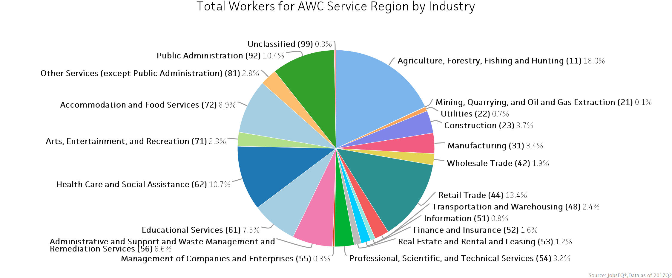
Scope of Scan
  Researched community needs

Slide 12
Scope of Scan
  Researched community needs

Slide 13
Scope of Scan
  Researched community needs

Slide 14
Scope of Scan
  Researched community needs

Slide 15
Resources Used
List all resources used in developing the impact statements
Works Cited
"Advising Worksheets." Academic Advisors | Arizona Western College. N.p., 01 Mar. 2017. Web.
"Advising Worksheets." N.p., 01 Mar. 2017. Web.
"AZTransfer | College Planning for Arizona Students." AZTransfer | College Planning for Arizona Students. N.p., n.d. Web.
"Institutional Effectiveness, Research, and Grants ." Institutional Effectiveness, Research, and Grants | Arizona Western College. N.p., n.d. Web.
"JobsEQ." Labor Market Data. N.p., 5 Sept. 2017. Web.
"Transfer Services." Transfer Services | Arizona Western College. N.p., n.d. Web

Slide 16
Impact Statement 1
  There will be an increase of job opportunities in the Arizona Western College (AWC) service areas over the next 10 years. This increase will require AWC programs to meet the workforce demands.

Slide 17
Impact Statement 2
    A decreasing percentage of students of postsecondary education will receive college “degrees”. Flexibility in stackable, transferrable, and industry recognized credentials will help to ensure the relevance of Arizona Western College.

Slide 18
Impact Statement 3
  With the advancements of the community workforce needs, AWC must be ready to provide the educational opportunities using a model that meets student’s needs.

Slide 19
Q&A
Discussion w/participants

