Slide 1
Strategic Plan Update & 2024 Innovation Fund Townhall December 2023

Slide 2
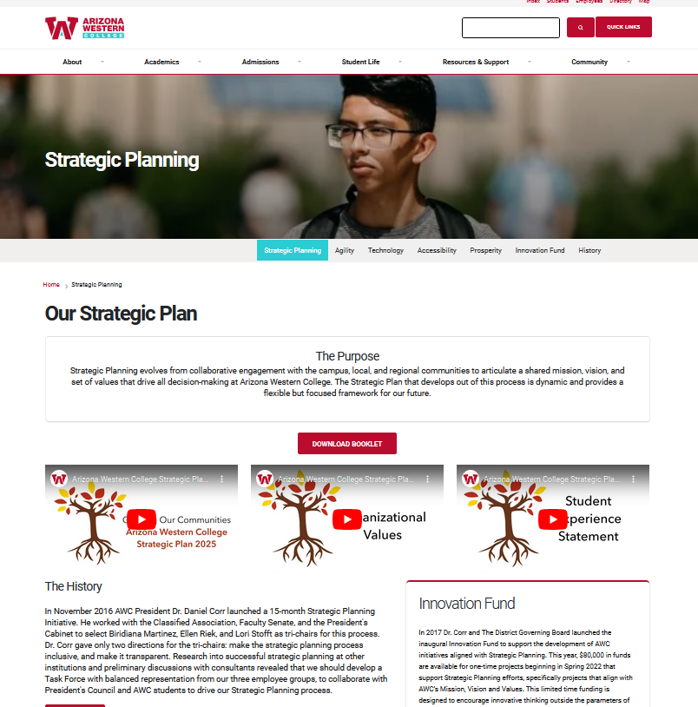
Kickoff for Plan Development – Jan 2017 Horizon Symposium – April 2017 First Innovation Projects Launched – Dec 2017 Strategic Plan Launch – Jan 2018 Student Food & Feedback – Sept 2018 Pathways Framework Adopted – Nov 2018​ Disaggregated Data Party – June 2019​ Taste of the Future – October 2019​ Strategic Plan status report – July 2019​ 2nd Horizon Symposium – Nov 2019 Implementation Council – March 2020​ Stopping To Contemplate – May 2020​ Streamline: Stop to Reinvent – June 2020​ Shared Governance Launch – August 2020​ Faculty Leadership Academy – Aug 2020 SP Status & Innovation Funds Townhall – Dec 2020 SP Status & Innovation Funds Townhall – Dec 2021​ ​ SP Celebration & Remaining Work – May 2022 SP Status & Innovation Funds Townhall – Dec 2022
Launching & Sustaining the Plan
Notes:
January 2017 – Strategic Plan Kickoff on campus April 2017 – Horizon Symposium to bring the community into the process December 2017 – Strategy Review and Community Feedback January 2018 – Strategic Plan completed March 2018 – Implementation Teams launched April 2018 – Strategic Planning Plenary Session August 2018 – Implementation coaching and team-building December 2018 – Implementation Update Townhall January 2019 – Shared Governance Townhall May 2019 – Implementation Team Workshop September 2019 – Disaggregated Data Party October 2019 – Taste of the Future November 2019 – 2nd Horizon Symposium

Slide 3
Values
Accessibility
BHAG
Guided Pathways / Data-Drive Class Schedule / HS Articulation / Wrap Around Services / OER / Resources Management
Student
Experience Statement
Technology
Mission
Vision
Tech Literacy / Increased Automation /
Enriched Tech / IT Audit Remediation
Agility
Innovation
Fund
Shared Governance / Sensible Work
Flows / Cross Training /
Professional Development
Prosperity
Guiding Principles of Learning (GPL) / Prior
Learning Assessment (PLA) / Economic Growth & Program Development
The Plan Elements
Notes:
Thank you, Ellen, Biri, Vanessa and Ana -

Slide 5
Ongoing Work of the Plan
Guiding Principles for Learning | Prior Learning Assessment
Guided Pathways + HS Articulation | Create Sensible Workflows
Shared Governance | Cross Training Model & Professional Development Model
Open Educational Resources (OER) | Data Driven Class Schedule

Slide 6
Prior Learning Assessment
AWC has moved from 3 forms of PLA to +40.
Students can now receive college credit for knowledge and skills from OJT, military, or other life experiences.
Includes: Microsoft Office Specialist, CompTIA A+, Cisco Certified Network Assoc, HLS
Students save time and money by reducing the number of courses they have to take to complete a degree or certificate
Increases access to education; increases equity
Notes:
Thanks to Reetika & Martha!

Slide 7
Guiding Principles for Learning (GPL)
The 5 GPLs are supporting learning at AWC in the following ways:
Aligning assessment with teaching, activity and learning outcomes by enhancing and making desired learning goals clear for student outcomes
Future plans include utilizing the Guiding Principles for Leaning in AGEC criteria
Working on ways to utilize a “by faculty for faculty” model to support professional development and help guide the use of Guiding Principles of Learning imbedded in curriculum
Notes:
Thanks to Shara!
Guiding Principles for Learning
AESTHETICS & CREATIVE THINKING
Students develop an expanded awareness and appreciation of the arts and sciences through the exploration of the human imagination and its expression.
COLLABORATION & INCLUSION
Students communicate and cooperate in order to respect similarities and differences among diverse perspectives and experiences.
ANALYTICAL REASONING & METACOGNITION
Students think critically and self-evaluate to identify, analyze and solve problems in a variety of situations and areas of study.
ETHICAL GROWTH & WELLNESS
Students act ethically and responsibly in personal, academic, and professional settings and strive to develop overall well-being.
APPLICATION & CREATION OF KNOWLEDGE
Students apply learning in new contexts and create knowledge in innovative ways.

Slide 8
Guided Pathways
CRM Engage platform for students is new, great data source
Pipeline AZ platform, also new, could really gain traction
52 faculty used CRM Engage Faculty Experience Portal to create 1,030+ alerts to support students since Fall '21 (incomplete assignments, applause, excessive absences)
100+ students have used CRM Engage to submit requests for assistance since launch this summer (a class, changing majors, or graduation; help with advising
Real-time custom dashboards made for ADs /Lead Faculty
We have 23 FT Faculty now advising inside CRM portal
Notes:
Thx to Marco
Marco's notes on GP growth are extensive – please reach out to him if you have any questions
Pipeline Az – job, career, education search

Slide 9
HS Articulation
First Dual Credit Conference @ AWC in April was a big success (will repeat May '24)
Four members of AWC team attended National Alliance for Concurrent Enrollment Partnerships
Changes in HLC credentialing requirements, articulation with HS partners, and subsequent DE increases at the heart of expanding access to college courses for regional U-18 students.
Notes:
Thank you, Ellen, Biri, Vanessa and Ana -

Slide 10
Shared Governance
Decision Making Grid finished and in use
Concerns about Councils, DMG or other SG items come to Governance Assessment Committee (Vice Chairs)
5 Master Councils meeting 1st Wed of the month
College Governance Council meets 3rd Wed of the month.
Anyone can attend, all resources on OneDrive/
Sharepoint / Workplace
Notes:
Thanks, Laura and Julia!

Slide 11
Open Educational Resources
Open Textbooks for Rural AZ grant partners us with 7 other rural Az colleges
Adaption of existing OER materials in various disciplines (incl. sciences, math, humanities) is ongoing
OER material is no cost to students
Tymmi Woods, Distance Learning Librarian, and Scott Donnelly, OER Faculty Lead host info sessions around the district
Notes:
Thank you, Scott Donnelly & Tymmi Woods

Slide 12
Creating Sensible Workflows
Working on focused subcommittee work
Employee Onboarding – check lists, streamline process
Self Service Reqs – Complete! Training ongoing
Budget Transfers – testing phase, final by 12/31
IT Service Tickets – process map, workflow final!
Colleague Access – testing underway
Notes:
Thanks to Jacqueline Quinonez
Onboarding was formed out of a Granger session, and that's now a subgroup of this Sensible workforce committee, with a focus on PRIOR to start-date work, and immediately after starting. IT and Facilities part of that team.

Slide 13
Professional Development Model
Organizational Development & Instructional Quality partnering to offer prof. dev., workshops, and info sessions on robust topics. Spring '24 calendar is coming soon; incl. topics to support requests and awareness on college-wide directives
Institution-Wide PD model to support new employees to include onboarding, 90-day experience, intentional and impactful development to support success.
Continue to strengthen emphasis and completion of annual required training such as Title IX, FERPA, Cyber Security.
Director of Organizational Effectiveness & Development recently
announced, Julia Howe is joining the HR Team.
New Faculty Professional Development model coming Fall '24,
under the leadership of VPLS Dr. Kathleen Iudicello.
Notes:
Thanks to Kathy O and Julia H
Trainings offered during COmmon Hour, and frequently repeated on Thursday mornings
Thanks to employees who have requested topics be covered.
Thanks to everyone for attention to annual required trainings

Slide 14
Data Driven Class Schedule
Move to data-driven class schedule met the 70% threshold in the first year (same desired classes at the same desired times semester-to-semester)
Challenge was finding enough faculty to teach the classes in the new schedule
Suggestions include: Proactively adding faculty lines in high-demand areas; Investing in true scheduling software and reduce manual entry; Re-stablish original cross-functional committee to create shared vision, buy-in
Notes:
Thanks, Laura and Julia!

Slide 15
What’s Next for the Plan?
This plan sunsets in 2025
DGB will consider how to approach this work with Dr. Corr
Ideas from our recent Strategic Plan Bootcamps include:
Audit Plan & Refocus on current priorities - some things need to get traction
Guided Pathways is not complete, consider a 2.0? Engage CRM & Pipeline Arizona both new
Mission, Vision, Student Experience – really good - Add an Employee Experience?
BHAG – hold up Strategic Plan Objectives (i.e. Guided Pathways, OER, PLA, Tech) to see what impacts it. Also, modify BHAG – Prof / Certifications / Career Tech?
PLA Objective – review and assessment – include Learning Services subjects
Agility – consider Universal Design of Instruction

Slide 16
Let’s talk Innovation Fund Projects!

Slide 17
INNOVATION FUND STATISTICS
6 years of funding (2018-2023)
48 projects funded
$569,741 TOTAL AMOUNT FUNDED
Not including 2024 projects

Slide 18
Update on 2023 Funded Projects
Dave Riek – Siendo Primero - $10,000
Shara Skinner – Illuminate AWC - $15,000
Susanna Zambrano - Hungry Matador - $10,500
Abigail Maze/Marlie Meza – Science Area Study Area - $7,000
Michelle Thomas – CLUB SOTE - $22,620
Kevin Kato/Shawn Clavell – Human Wellness Lab - $20,645

Slide 19
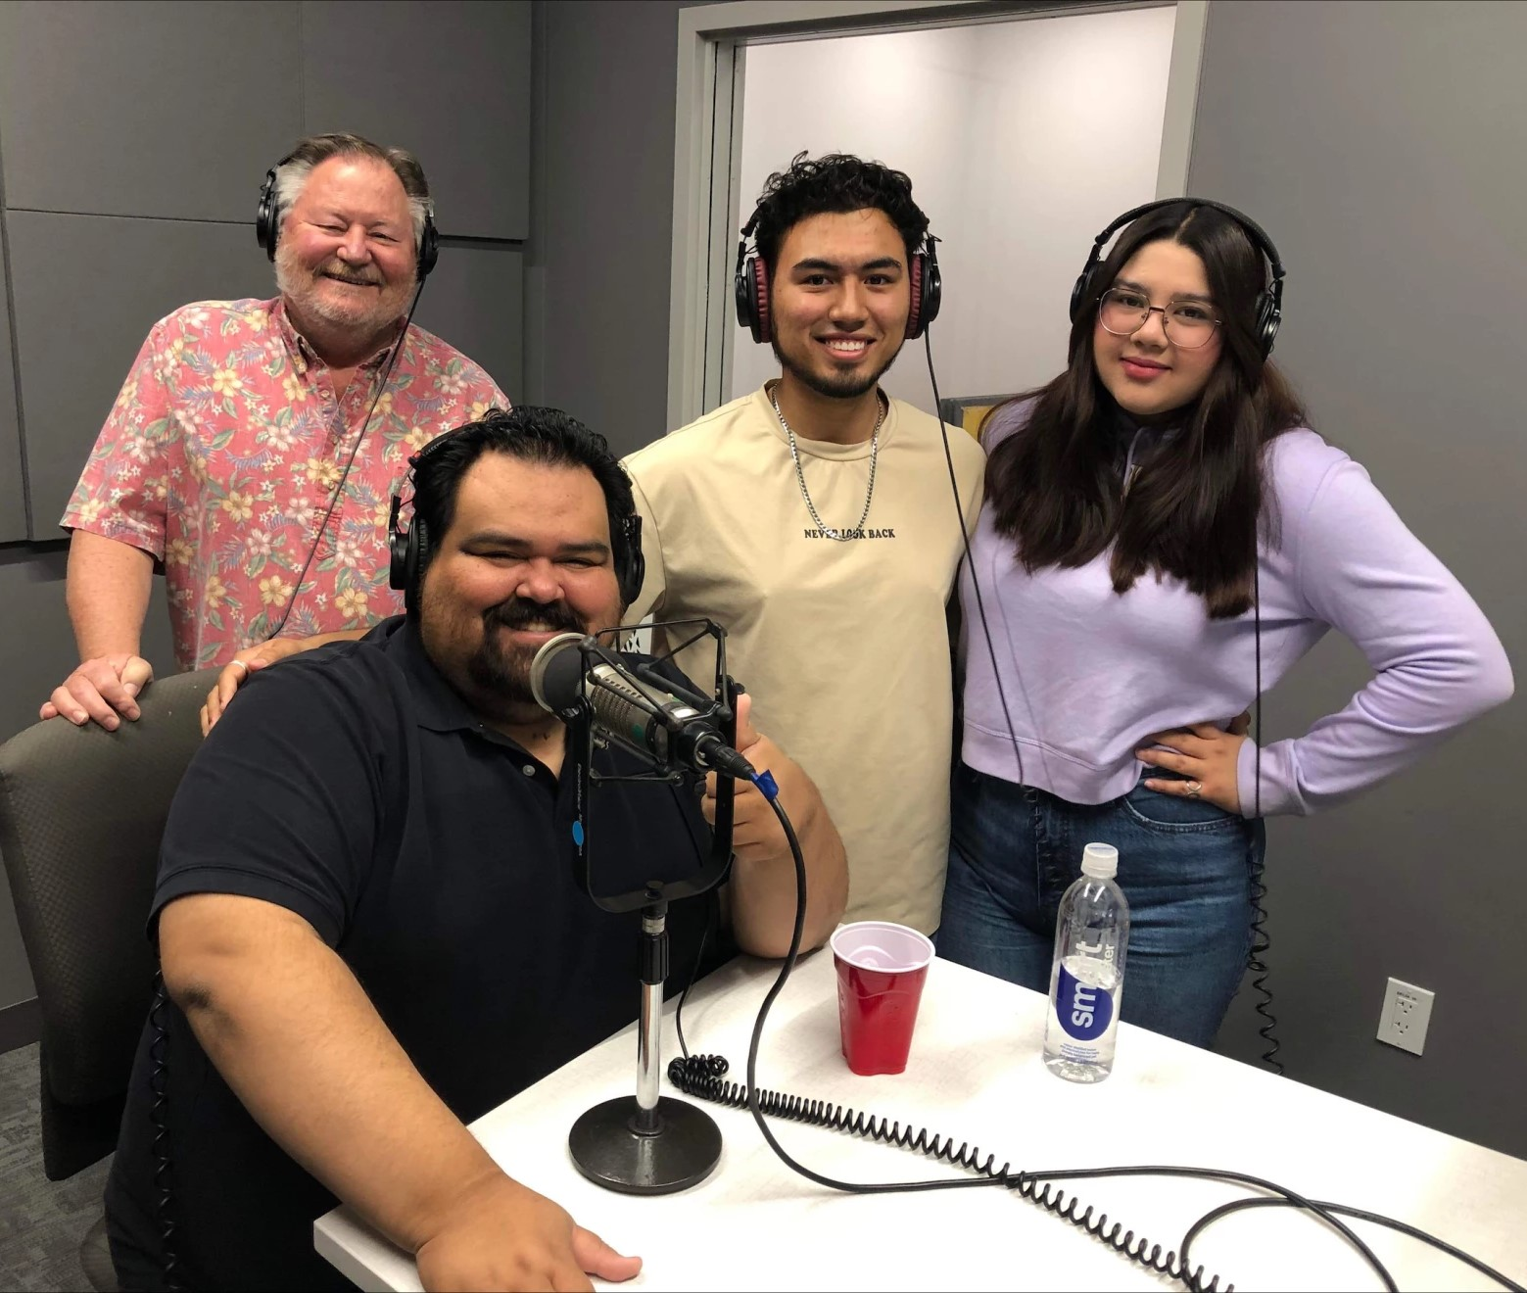
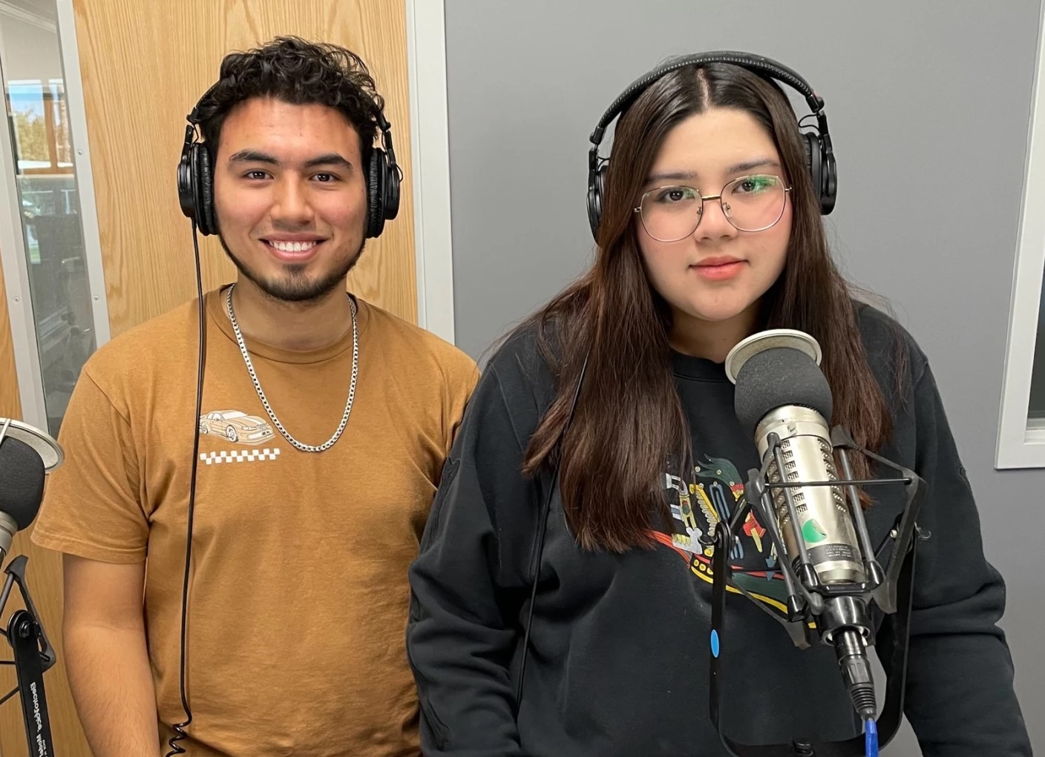
KAWC: Siendo Primero
KAWC team has hired a cohort of AWC and university students to produce a bi-lingual podcast including our new co-hosts Angelica Albarran and David Valdez.
Produced in our new studios in the MAC, the focus is on issues important to first generation college students presented primarily in Spanish. Also includes conversations with AWC staff & faculty who were themselves first gen and now work to support students.

Slide 20
SLLC: THE HUNGRY MATADORS
The Hungry Matadors project to create dining / gathering space at San Luis Learning Center has now become a combination CIP + Innovation Fund project. The refrigerator, two microwaves, and tables have been purchased. Also purchased were items and decorations to make the space more welcoming.
Currently we are waiting for facilities to put in a new sink and remove the carpet in the area so that the space can be used and enjoyed by students.

Slide 21
Illuminate AWC
This project had to pivot slightly due to costs. Illumination of the 3C building is no longer an option.
The 'audience' lighting at the AWC Amphitheater for both safety purposes and to make the area more attractive will be updated. (The existing lights are approximately 15 years old.)
Also investigating a way to light up the EB Building back wall behind the audience to enhance the audience/student experience when attending an event at the Amphitheatre.

Slide 22
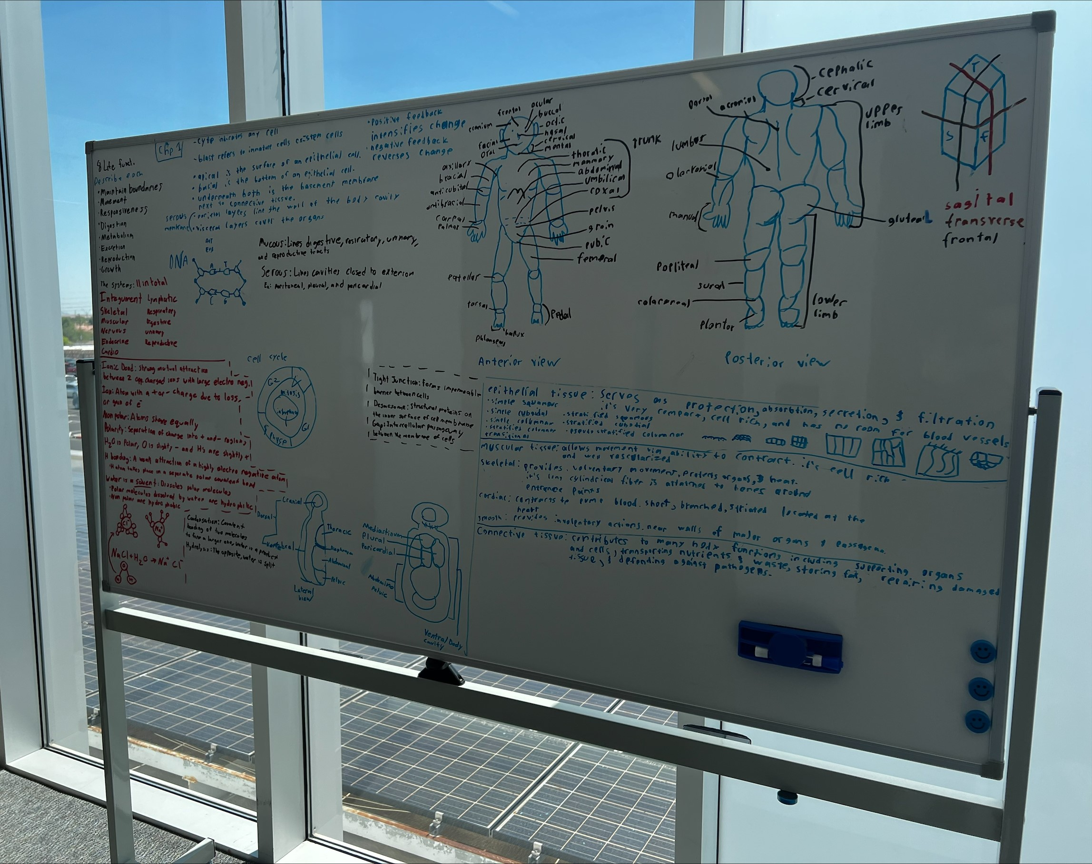
Science Club Furniture
To create a highly functional / collaborative student space on the 2nd floor landing of the AS building. This area now features three versatile tables that can be joined to form a large workspace, plus modular seating in AWC's new colors. The 4 x 6 double-sided whiteboards are utilized weekly for group studies and collaborative projects. This is now a hub of student activity throughout the day.

Slide 23
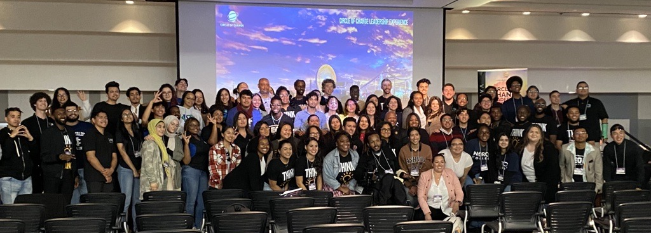
First Gen Empowerment Symposium
PHASE I. (Fall 2022): Four Club SOTE members attended a Student Leadership Conference in Long Beach, CA to be empowered and trained so they can bring the knowledge learned to the student body here at AWC.
PHASE II. (Spring 2023): 98 AWC and High School students attended First-Generation Student Empowerment Symposium on the AWC campus that was planned by Club SOTE students.
PHASE III. (Spring 2023): 14 AWC students attended the Circle of Change First Generation Student Career Conference in Miami, Florida to gain exposure to diverse cultures, thoughts, and points of view which encourage students to see the many possibilities open to them.

Slide 24
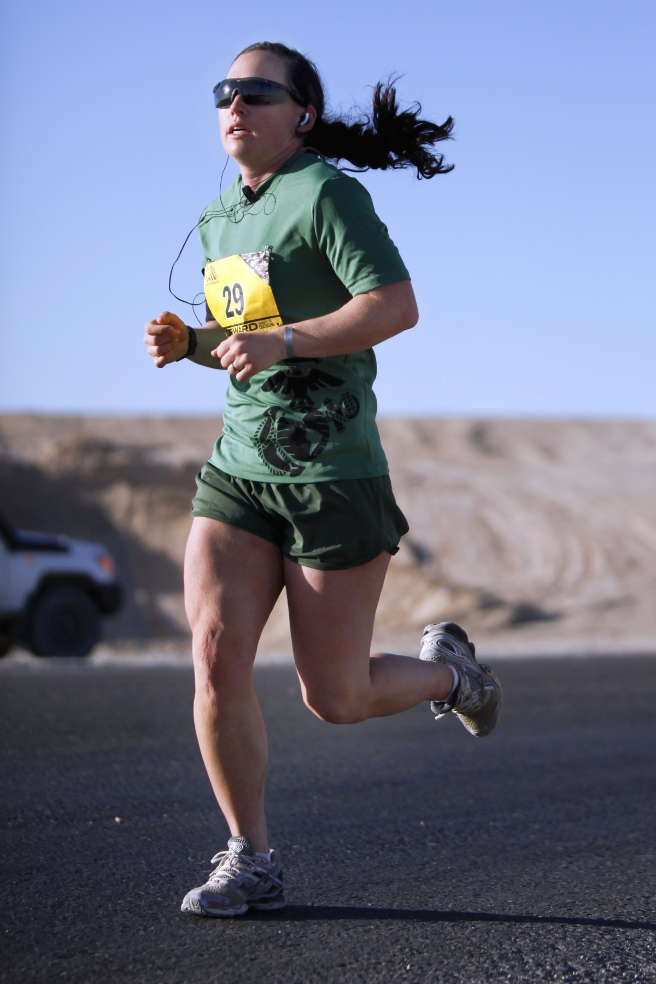
The Human Performance Lab
This project is designed for people to use health assessment equipment, vitals screenings, mobility testing. For students in many fields, including anatomy/physiology, allied health, exercise science.
Professors Kevin Kato and Shawn Clavell have waited to order the Vitals Cart equipment pending suitable space. Facilities will create a locked storage area in the Fitness center to house the equipment. Requisitions have been submitted to purchase the equipment.

Slide 25
And Now, for 2024 Projects
Drumroll, please

Slide 26
Project | Submitter | Amount | Caveat
leadHERship | Sara Amani | $20,000 | Partial Funding
MAC Visual Arts Display | William Bloomquist | $3,750
Yuma History Map | Ellen Riek | $13,700
Living Walls | Tosha Gillespie | $15,000
Assistive Tech. Lab Renovation | Lisa Swenson | $5,850 | Partial Funding for furniture pieces/seek help from facilities for repairs.

Slide 27
Project | Submitter | Amount | Caveat
Bug Days and Beyond | Jacob Gibson | $2,600
AWC Enrollment Tour | Biridiana Martinez | $5,000
Our Part of Yuma History | Elizabeth Dawson/Angie Creel | $4,600
Updating Fitness Center Equipment | Jane Peabody | $10,000 | Partial Funding for equipment
Dac at the MAC | Shara Skinner | $5,500 | Partial Funding / one chair instead of two
TOTAL |  | $86,000

Slide 28
leadHERship
Sara Amani
leadHERship will foster enlightenment about issues that affect women and address gender inequality issues, as well as to drive change through community service. The program includes mentorship, workshops, and deep conversation help dismantle gender inequality, eradicate stereotypes, and assist women gain more confidence to pursue a life of impact.
To develop a curriculum for the entire year of 2024, there will be 10 workshops. Each workshop includes interactive activities, discussions, and opportunities for participants to engage with guest speakers and mentors. Also included, regular affirmation meetings and ongoing support for participants throughout the year.

Slide 29
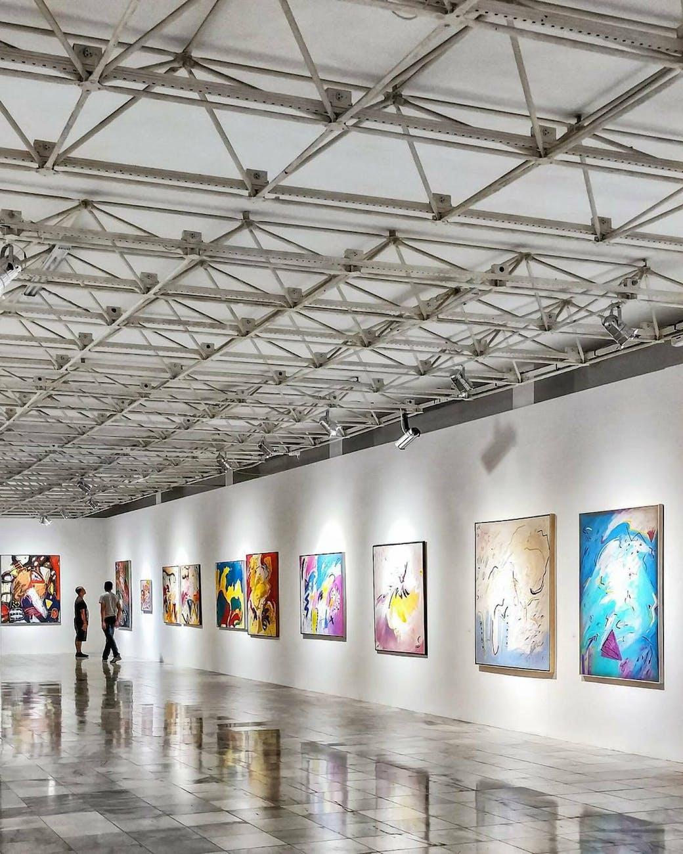
Bill Blomquist
The MAC Visual Arts Display
At AWC the visual arts engender achievements from a wide range of students. These achievements should be given prominence and pride of place.
In the new MAC, a wide corridor dividing the makerspace and television and radio has been identified as an excellent display area for wall art. This 50-foot-long space provides approximately 80 feet of wall, potentially a fine art gallery.
A professional hanging and lighting system will turn the space into an art gallery, protecting the walls while lighting and securing 2-dimensional artworks.

Slide 30
Yuma History Application Ellen Riek
This project addresses several aspects of the AWC Student Experience, Pillar 4 of Guided Pathways, serves the AWC mission by “creating partnerships” that will enhance and support “thriving communities”, putting AWC students at the heart of educating others about Yuma History.
Using an app called Cuseum, students will create rich digital content through the learned skills of historical research, storytelling and editing. It will promote the region in a collaborative way and, most importantly, engages students in sharing their work to educate others about our unique Yuma history.

Slide 31
Living Walls Tosha Gillespie
To create free-standing Living Wall indoor planters to grow lettuce/salad crops and herbs to create a visually pleasing, educational and air purifying experience.
The maintenance and design by the Ag Department and Ag course PLS-108 - Plants and People.
This project looks to close the circle by bringing plants to students and in the process working to reduce stress and increase air quality.

Slide 32
Assistive Technology Lab Renovation Lisa Swenson
To Increase student comfort and ease when accessing assistive technology and tutoring, supplementing their learning experience.
A change in atmosphere in this Lab would give it the clean, welcoming, and professional touch it desperately needs. Additionally, the AT Lab’s desks do not allow for any height modification, which is a possible accessibility issue for students with mobility aids, such as wheelchairs.
Includes a fresh coat of paint, new carpet, a front desk, study chairs, conference table, modern room dividers, chairs, height-adjustable desks, a front desk, and a new conference table; as well as to add two couches, an armchair, a side table, lamps, and a rug to create a separate comfortable / relaxed space for students.

Slide 33
BUG DAYS AND BEYOND Jacob Gibson
To inspire and encourage an interest in biodiversity and science. Specifically, this project will help grow an annual “Bug Days” festival and build educational resources for use in AWC classes and outreach.
This project will also allow AWC to acquire an excellent set of insect specimens. The durable specimens are mounted in epoxy, making them a perfect item for the “Bug Days” festival and outreach. These specimens will also be a valuable resource for many staple AWC science classes, elevating the experience of hundreds of AWC students each year.

Slide 34
AWC Enrollment Tour Biridiana Martinez
The AWC Enrollment tour was developed to expand resources into the community while nurturing the trust of high school partners to enhance the overall enrollment experience for high school seniors. While adapting to change post-Covid, the AWC Recruitment team saw the opportunity to innovate the delivery of services while adapting the 'meet students where they are' approach and creating a collaborative and engaging experience that is unique to the needs of each local high school campus.
This project supports the purchase of technology equipment to guarantee the same student experience at every high school campus. This would include portable screens, microphones, portable speakers and a projector.

Slide 35
Our Part of Yuma History
Angie Creel and Elizabeth Dawson
The AWC and NAU at Yuma Academic Library seeks to create a physical and digital archive containing unique items for our campus and community and to share with our campus through an interactive digital platform. Our archive will contain items like our original AWC catalogs, student handbooks, the development plan for the college, old pictures including scrapbooks and other documents, and Western Voice and Western Press newspapers. Additionally, AWC objects, such as old uniforms and important realia, will be included.
We want to purchase storage items and create our first-ever formal physical and digital archive. Additionally, to showcase these items, we want to purchase a touch screen portable smart screen monitor and base that will invite interaction with our digital archive and build awareness about our Yuma history.
Our Innovation grant requests are for storage supplies and a smart screen monitor and base.

Slide 36
Updating the Fitness Center Jane Peabody
With increased access to the AWC Fitness Center, it is past time to overhaul our aging equipment. We want to create an optimal experience for our students.
We need to reduce or eliminate malfunctions and disruptions on aging equipment so students can complete their routines.
This project embodies a holistic approach that underscores our dedication our students' well-being and satisfaction. In essence we are demonstrating our capacity to adapt to changing circumstances and priorities, a key aspect of this college and its strategic plan.

Slide 37
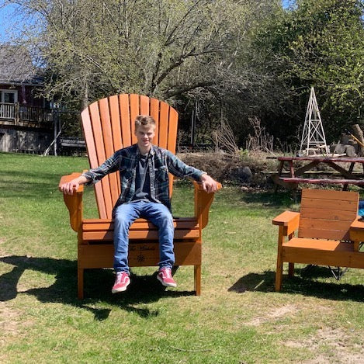
DAC at the MAC – Shara Skinner and SGA
This proposal requests two Oversized Adirondack (‘dack) seating to the MAC to create a Student Experience space for seating outside the new Matador Activity Center (MAC). Adirondack chairs are not just a piece of outdoor furniture; they represent a lifestyle of relaxation, outdoor living, and quality time. Paired with a new facility, this seating solution is a simple way for a sense of community to be supported and fostered.
The chairs would be AWC branded and we would Launch a month-long social media campaign across our platforms encouraging students to share photos of them sitting on the new chairs for a change to win a prize.

Slide 38
Congratulations to everyone!
We appreciate everyone who applied this year!
Innovation Fund Committee: Bryan Doak, Dr. Eric Lee, Dr. Nikki Hodge, Michelle Estes, Julissa Vargas, Karyn VanWhy, Ila Peterson, Ashley Herrington, Jodi Trout, Brenda Letender, Renee Munoz, Sara Snyder, Jillian Mason. Supported by Michelle Struck and Lori Stofft.

