Slide 1
Strategic Planning Bootcamp October 2, 2023

Slide 3
Building the Plan
Tri-Chair model
Kickoff for Strategic Plan Development – Jan 2017​
surveys
Forums
scan teams
data analysis
focus groups
Horizon Symposium – April 2017​
Innovation Projects Launched – Dec 2017​
Strategic Plan Launch – Jan 2018​
Steering Committee
Cross-Campus & Cross-Functional

Slide 4
Values
Accessibility
BHAG
Guided Pathways / Data-Drive Class Schedule / HS Articulation / Wrap Around Services / OER / Resources Management
Student
Experience Statement
Technology
Mission
Vision
Tech Literacy / Increased Automation /
Enriched Tech / IT Audit Remediation
Agility
Innovation
Fund
Shared Governance / Sensible Work
Flows / Cross Training /
Professional Development
Prosperity
Guiding Principles of Learning (GPL) / Prior
Learning Assessment (PLA) / Economic Growth & Program Development
The Plan Elements

Slide 5
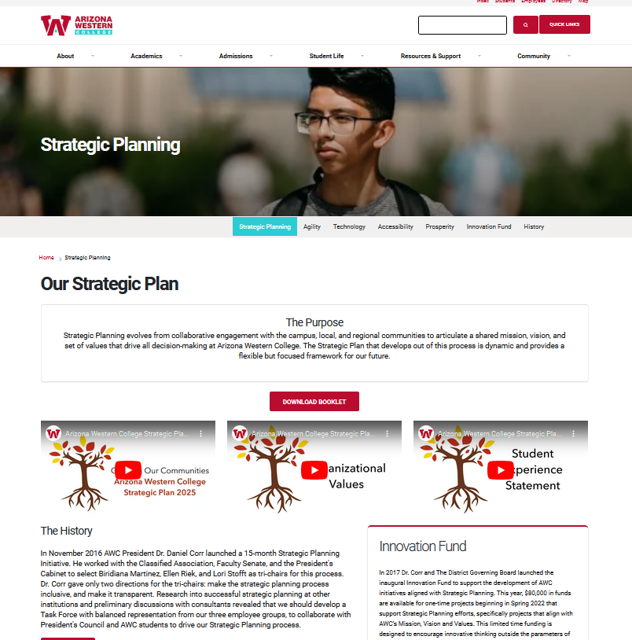
Student Food & Feedback – Sept 2018 Pathways Framework Adopted – Nov 2018​ Disaggregated Data Party – June 2019​ Taste of the Future – October 2019​ Strategic Plan status report – July 2019​ Implementation Council – March 2020​ Stopping To Contemplate – May 2020​ Streamline: Stop to Reinvent – June 2020​ Shared Governance Launch – August 2020​ Faculty Leadership Academy – Aug 2020 SP Status & Innovation Funds Townhall – Dec 2020 SP Status & Innovation Funds Townhall – Dec 2021​ ​ SP Celebration & Remaining Work – May 2022 SP Status & Innovation Funds Townhall – Dec 2022
Launching & Sustaining the Plan

Slide 6
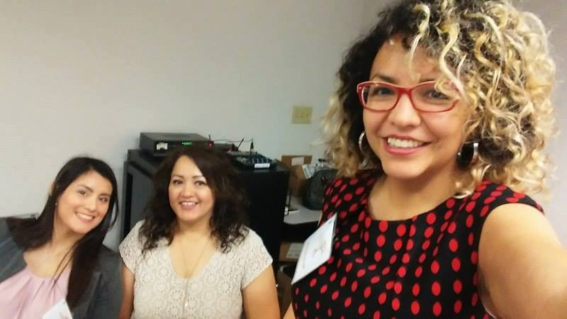
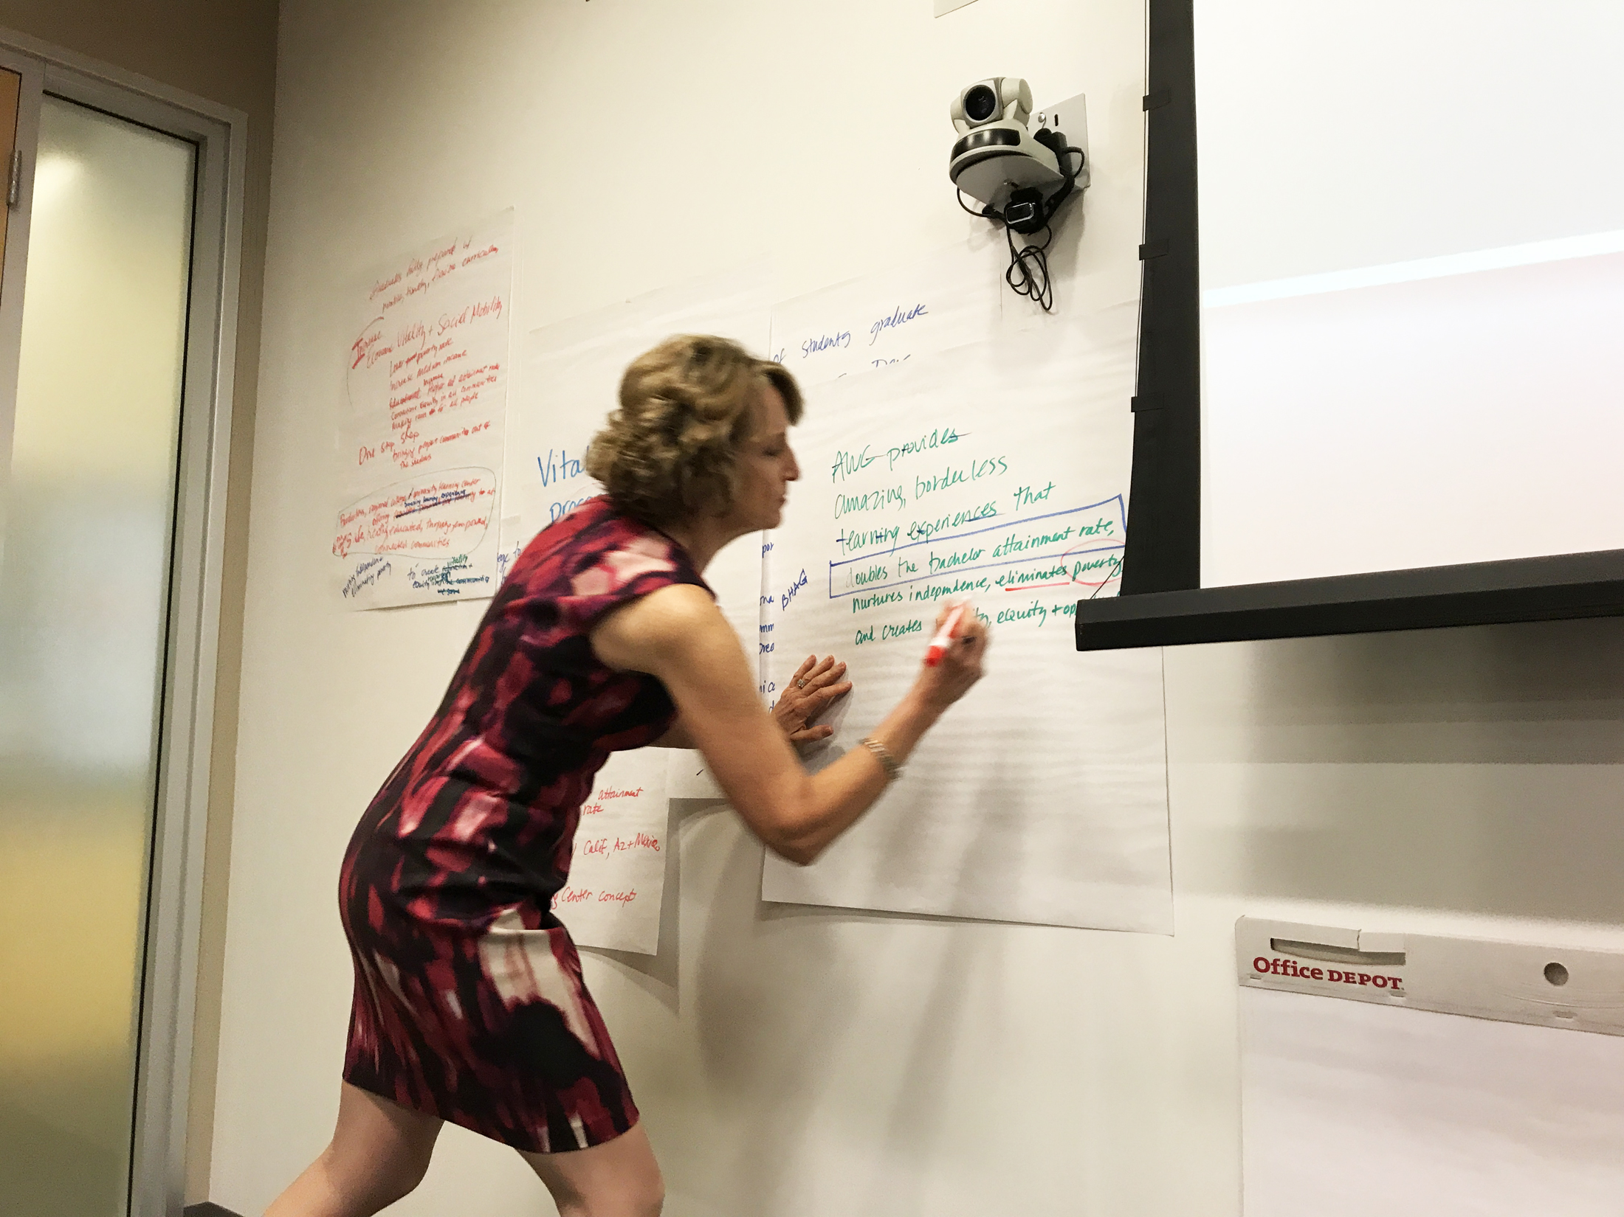
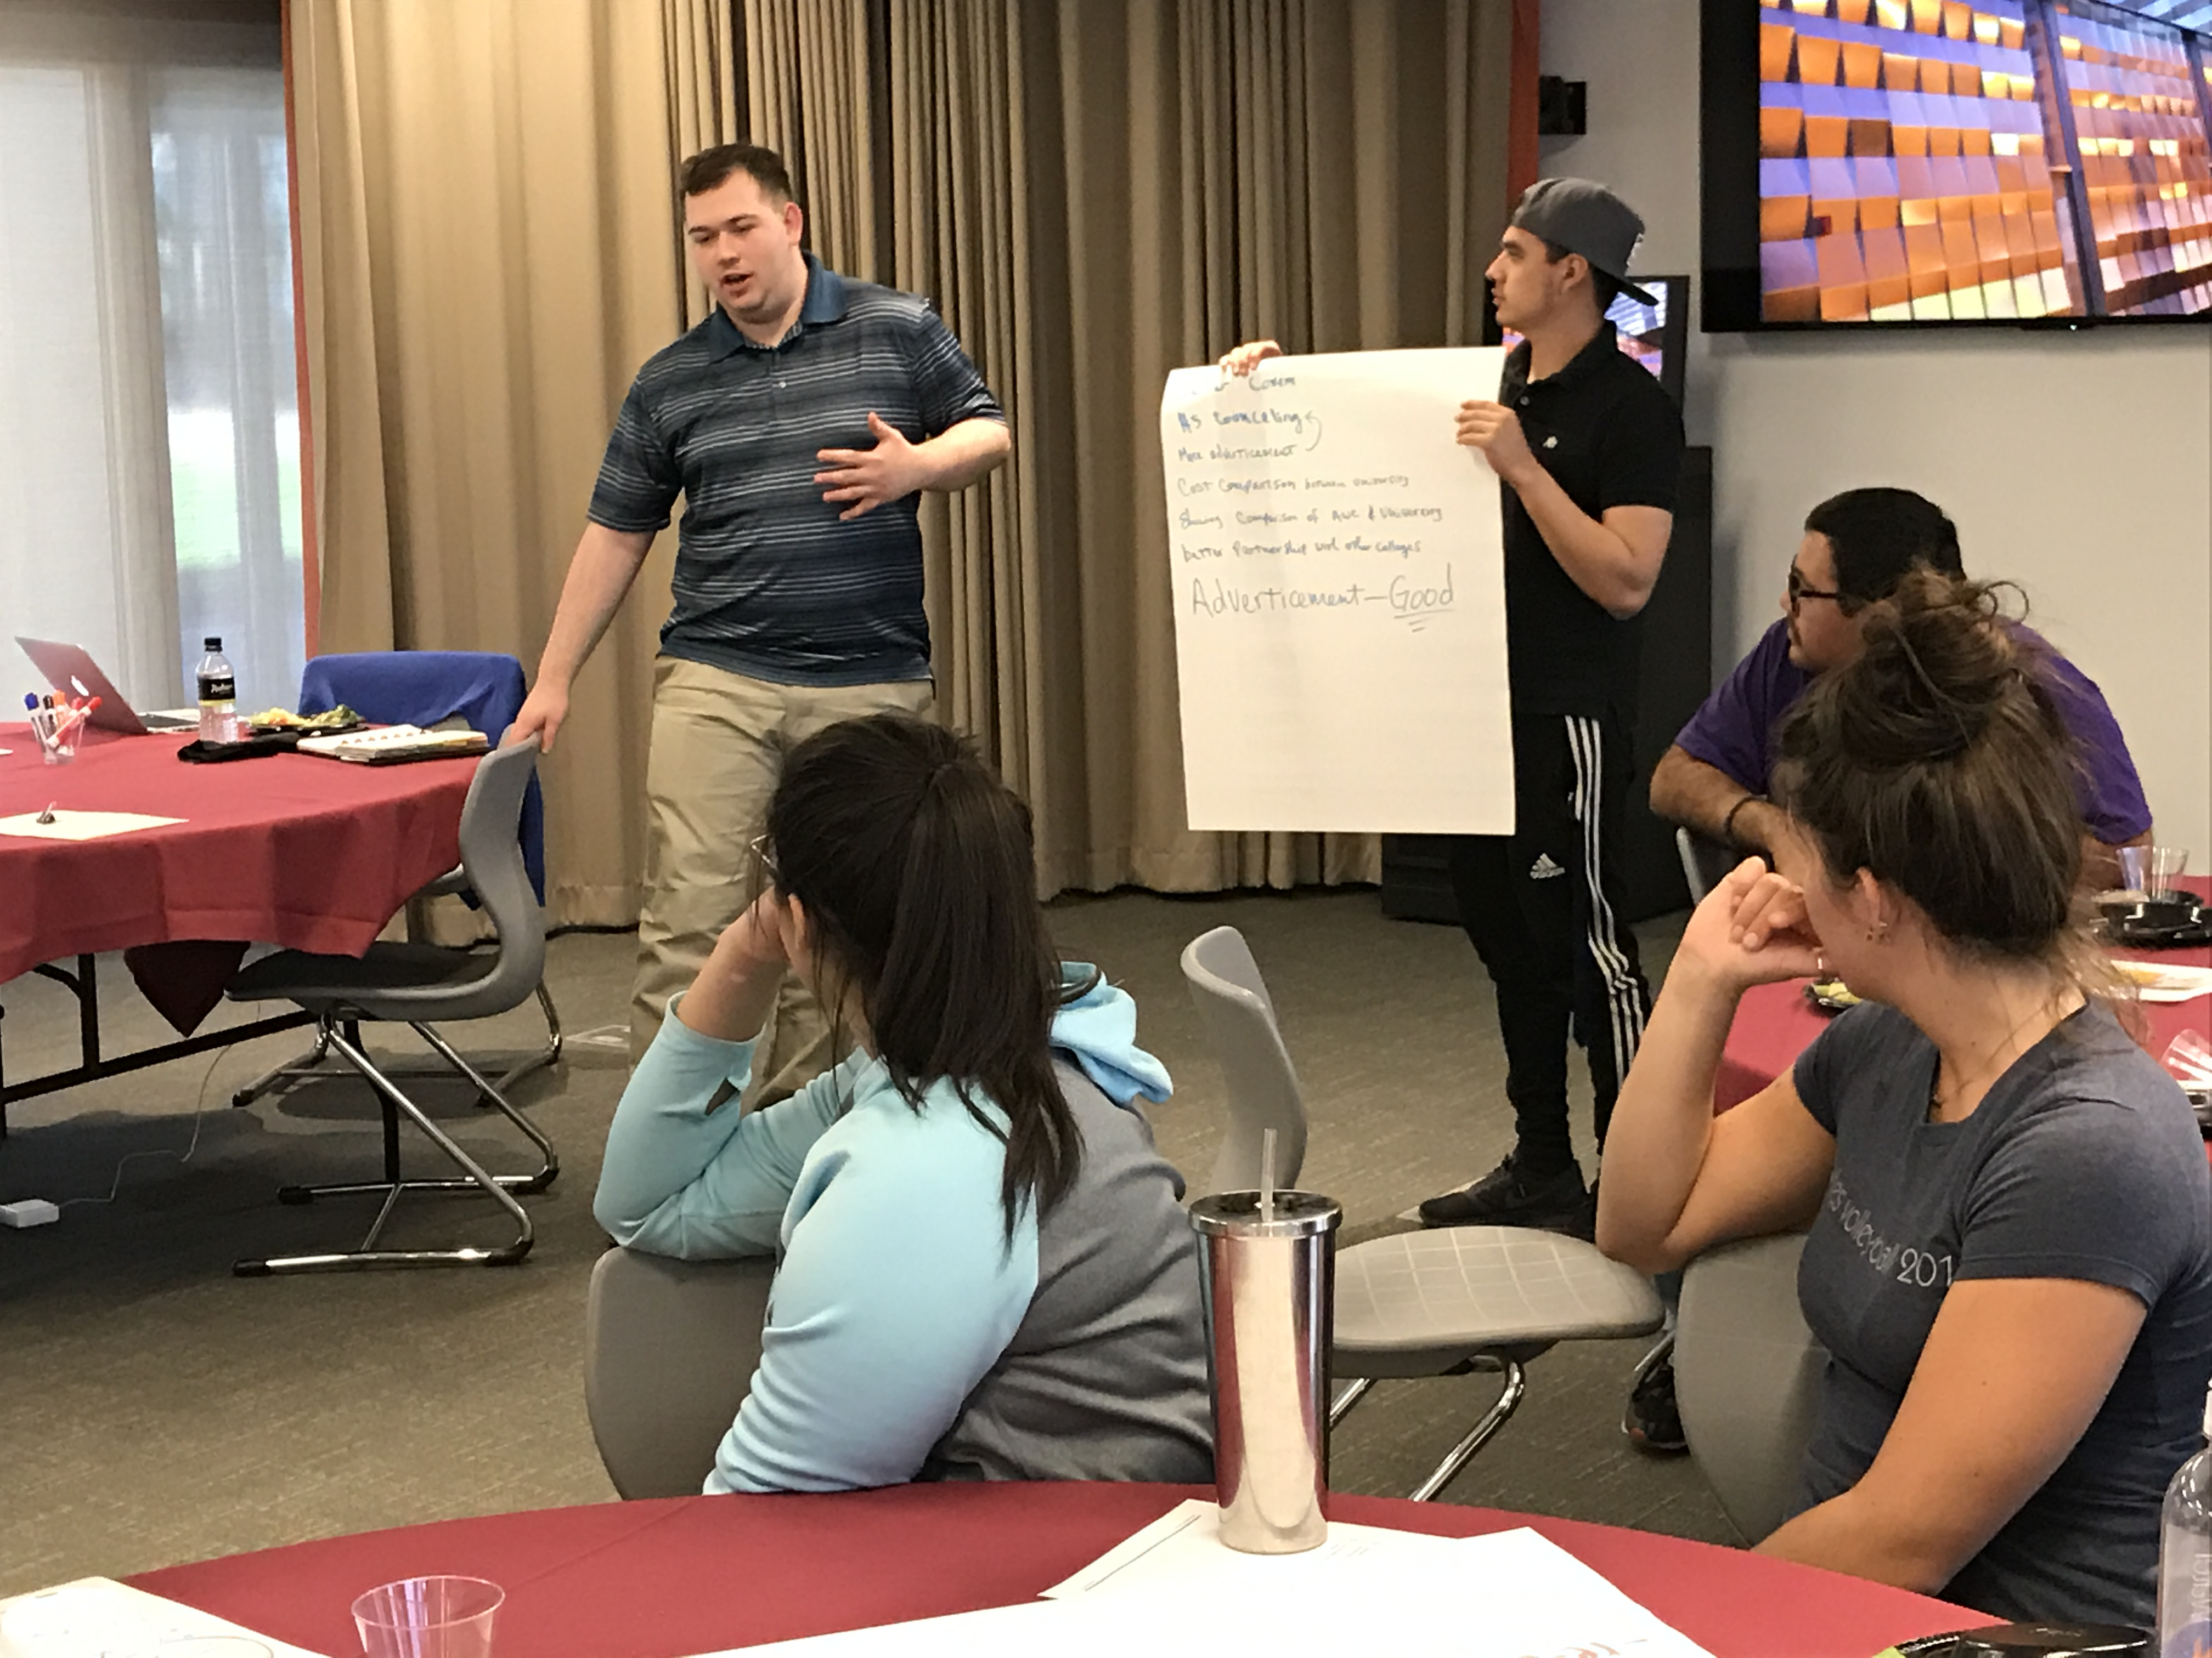
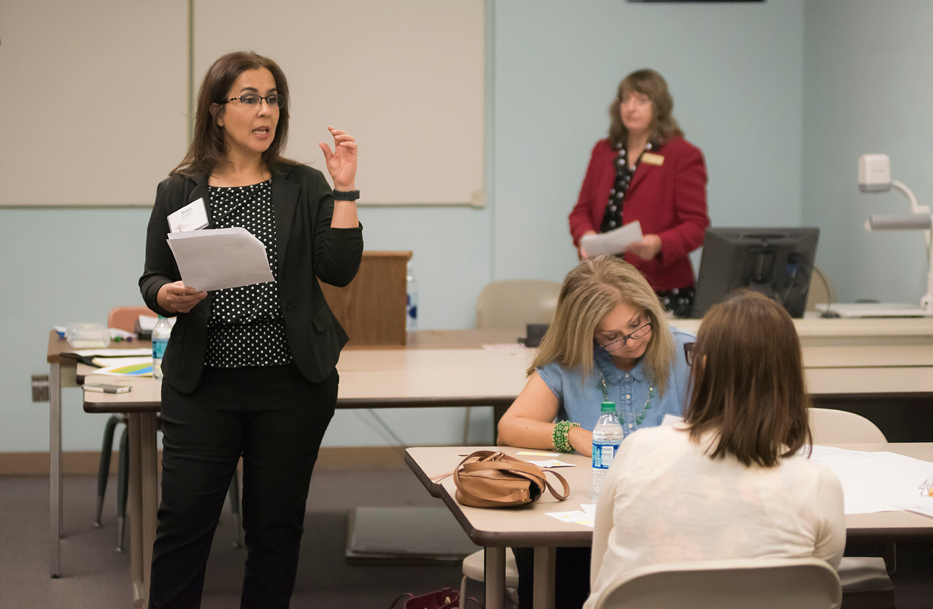

Slide 8
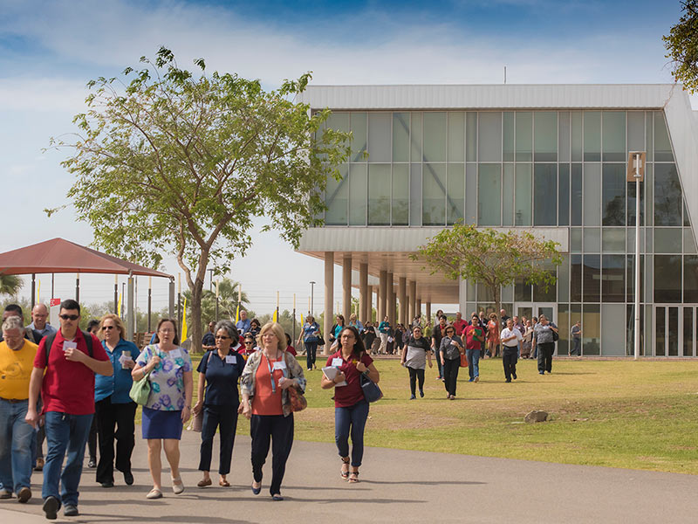
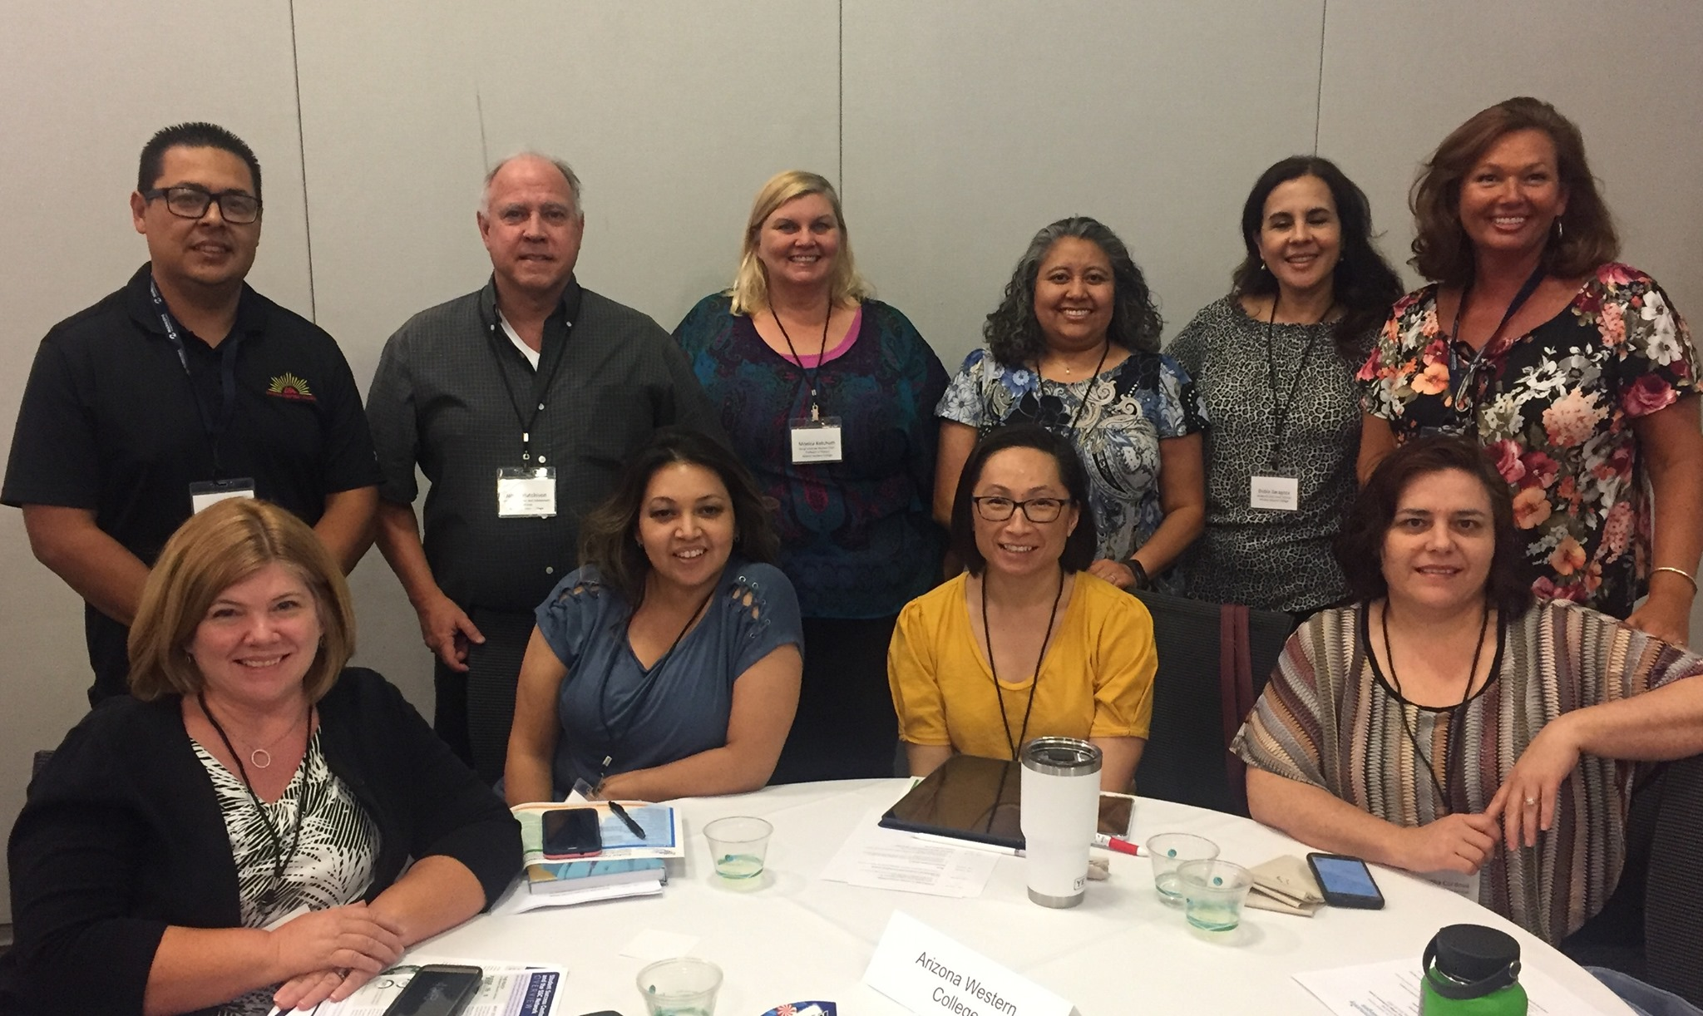
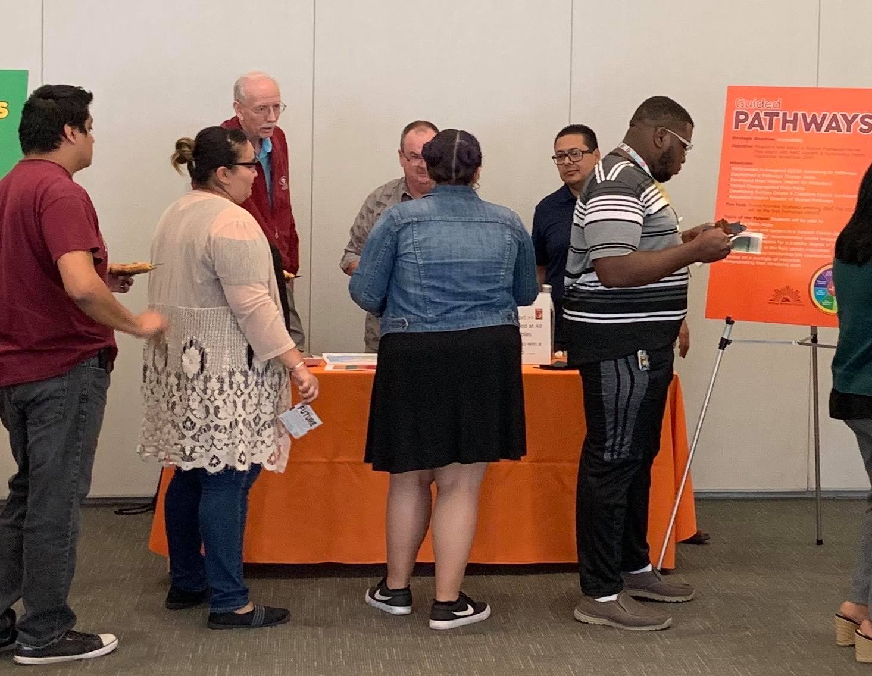
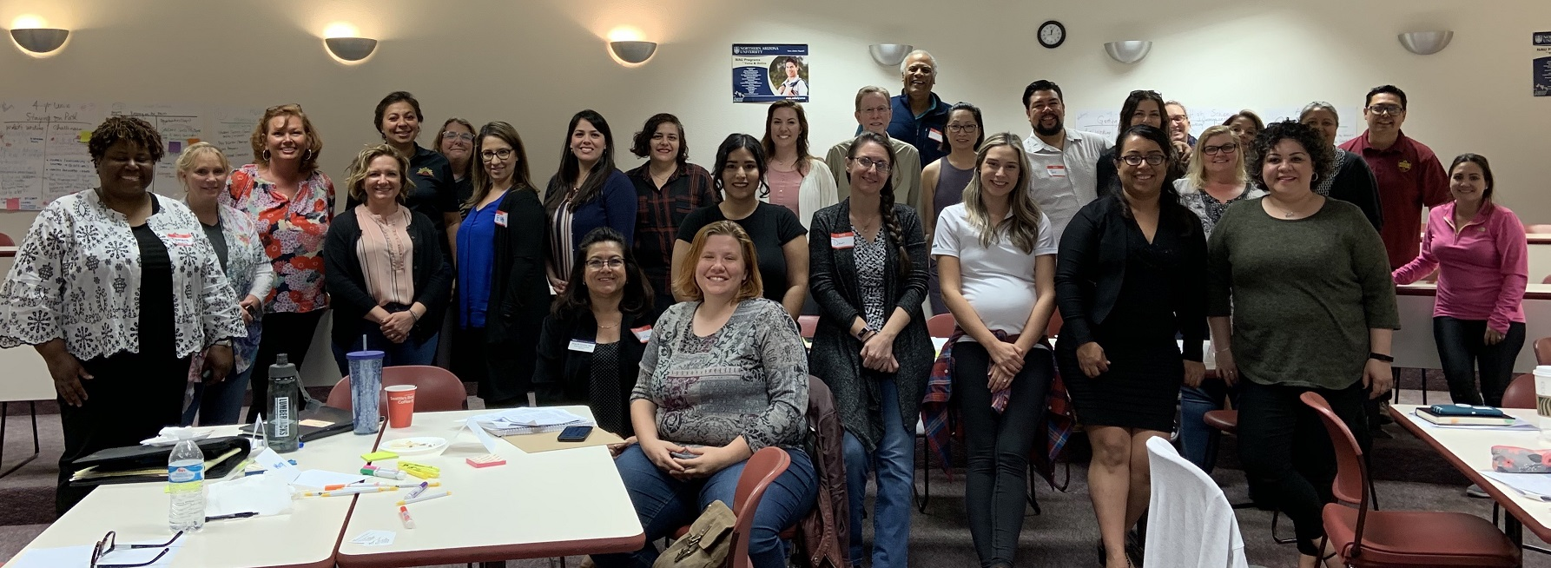
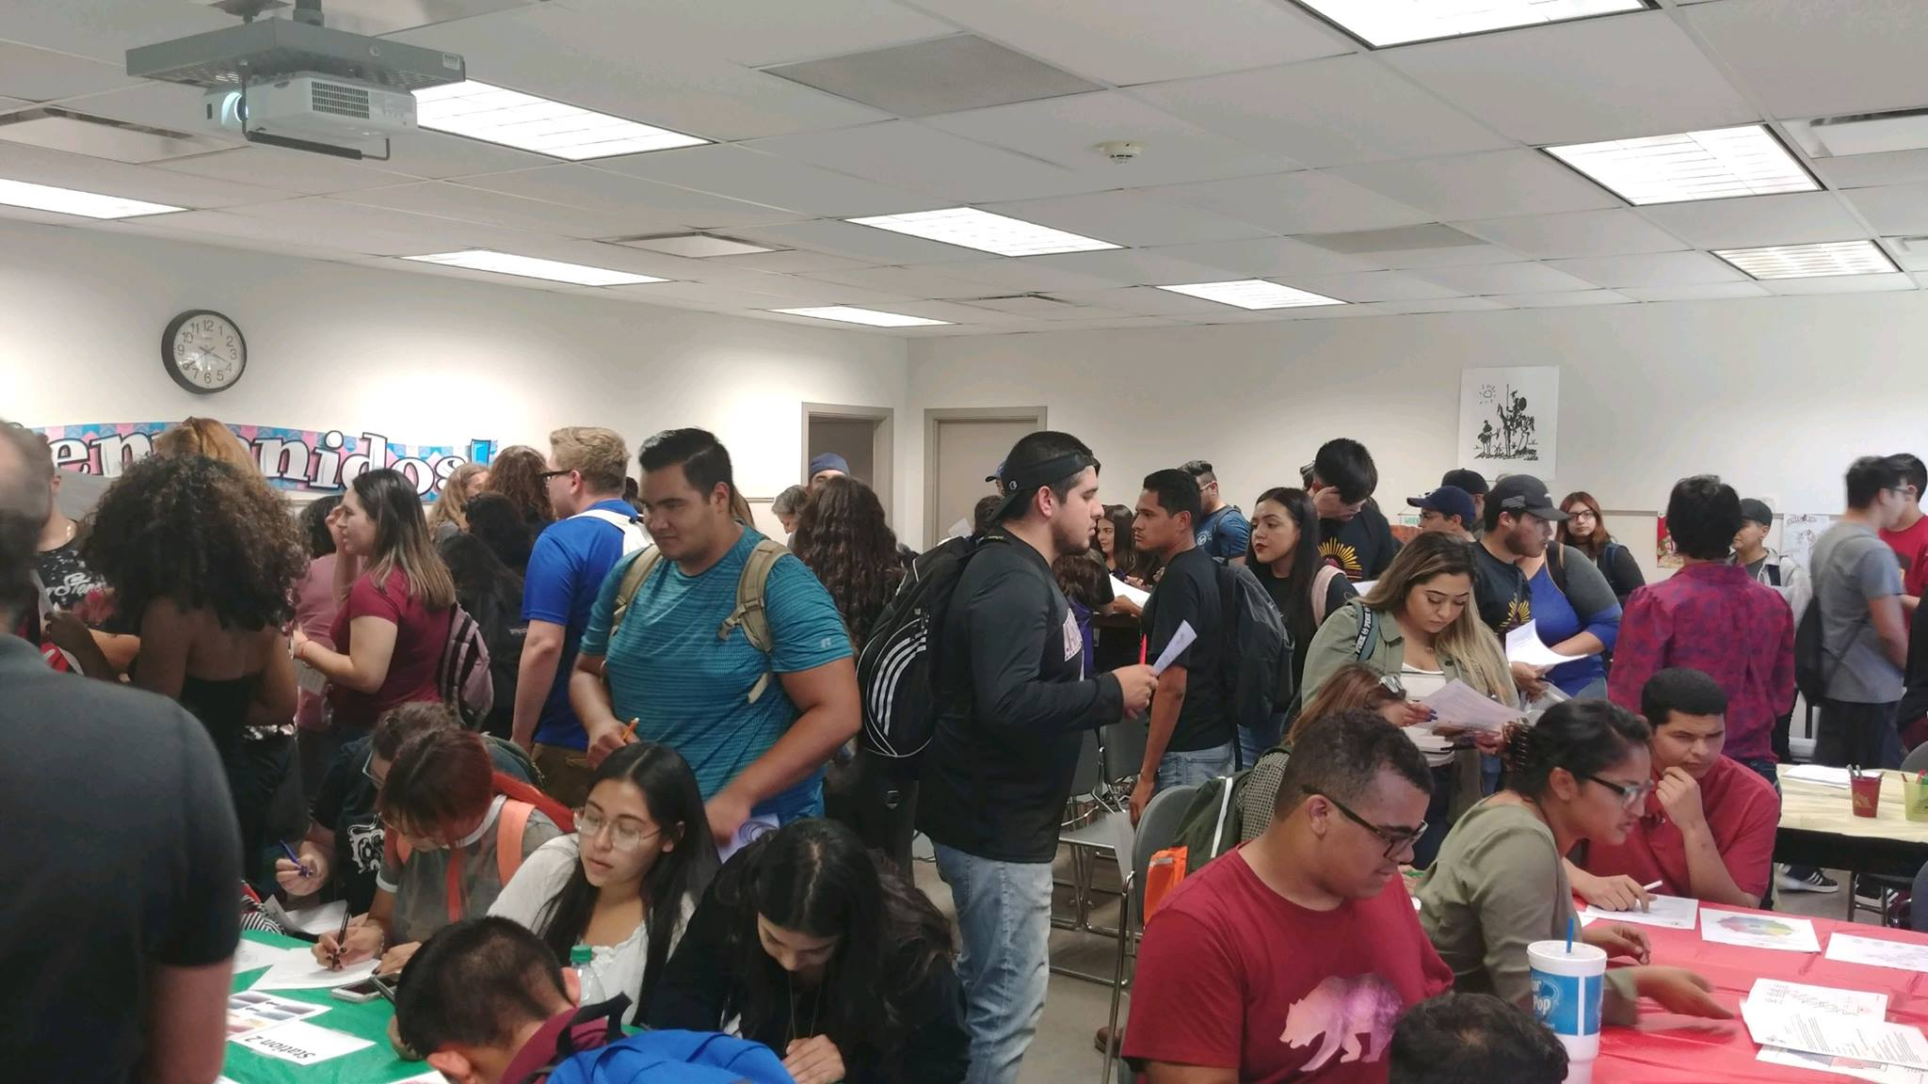
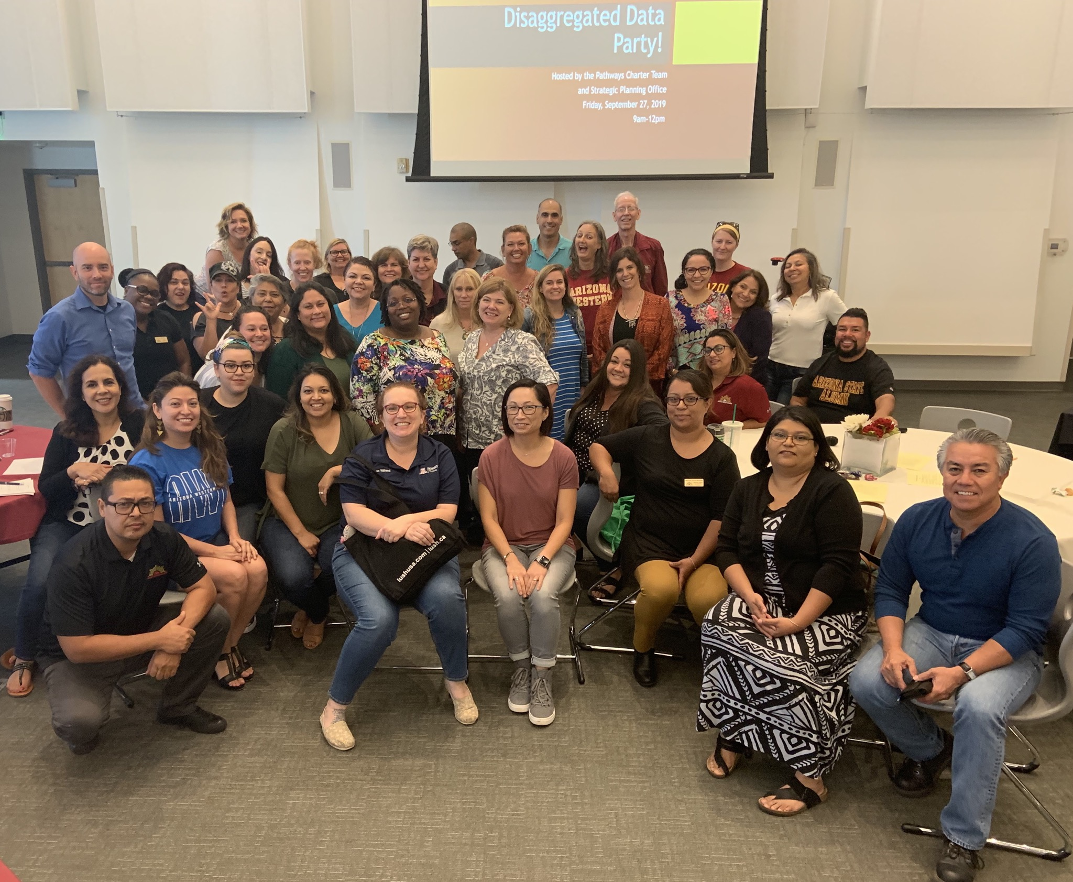
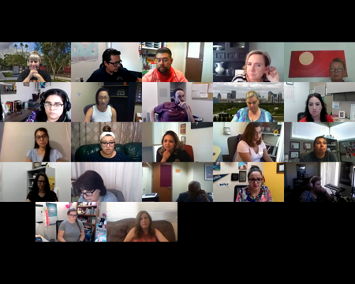
Arizona Center for Student Success inaugural convening
June 2019
Taste of the Future
October 2019
Horizon Symposium
April 2017
Vertical Planning Session with AWC, NAU, YUHSD
March 2020
Faculty Leadership Academy
August 2020
Student Food & Feedback
September 2018
Disaggregated Data Party
September 2019

Slide 9
And now on to Jeopardy!

Slide 10
Soapboxes

Slide 11
Planning for the Future
What SP events would we re-create in Spring 2024 for assessment, and planning?
Disaggregated Data Party, Student Experience Pizza Party, Taste of Future, or something else?
Brainstorm to send Dr. Corr and DGB our best advice for preparing to build the next plan
What would you keep
What would you let go
What would you focus on instead?

